Slide 1
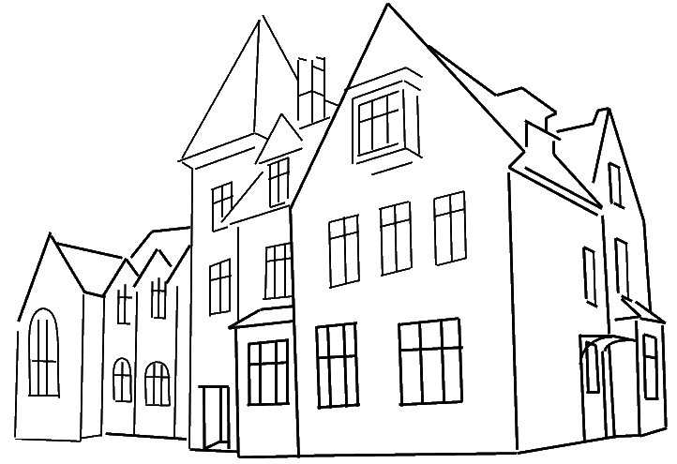
Mayhill Junior School Year 6 SATs 2024 Presentation for Parents, Carers & Guardians

Slide 2
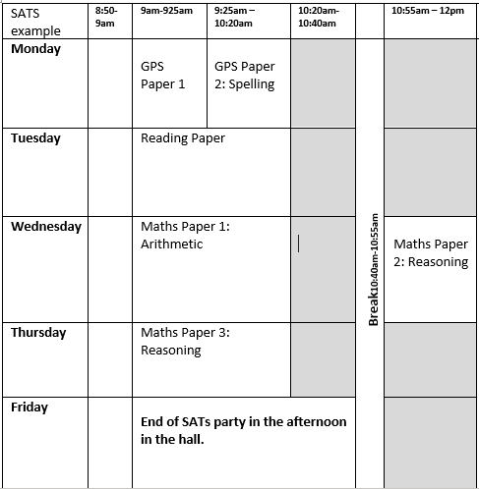
What are SATs?
SATs are the Standardised Assessment Tests that are given to children at the end of Year 2 and Year 6 to check their educational progress. They are one marker used by the government, and hence parents, of the quality of the education at a school.
The SATs take place over four days, Monday 13th May -Thursday 16th May.
Writing is assessed using evidence collected throughout Year 6.
There is no Year 6 SATs writing test.

Slide 3
Points to remember about SATs
SATs focus on what children know about Maths and English.
They will not reflect how talented they are at science, geography, art, PE…, and they certainly won’t highlight all of their amazing personal characteristics.
SATs don’t tell the whole story.
Their results will say if they did or did not meet a certain standard but not necessarily by what margin. These thresholds change each year according to the overall national performance, so what was classed as ‘meeting the expected standard’ this year might not be the same as last year.
SATs are only four days out of a whole Primary School career.
In reality, there’s one or two papers each day that last 30 to 60 minutes.
They don’t define the whole child – we work hard to make the
children understand that SATs will not define their life in anyway.

Slide 4
How are SATs used?
For the school, SATs are used to track progress from KS1 SATs papers taken in Year 2.
Secondary Schools will use this data but a child’s SATs result do not determine which English and Maths sets they will be put in, as Secondary schools will also conduct their own test (CATs) within the first few weeks of year 7.
Together, CATs and SATs data give them an idea of the child’s current attainment.

Slide 5
How are Mayhill helping to prepare the children for SATs?
We try our best to give the clear message that we just want to see them try their best.
Practice papers are completed leading up to SATs for:
Teachers to see gaps in knowledge/skills to inform our teaching
To practise test conditions – we want the children to be aware of expectations and therefore less worried about what will happen on the day.
To share progress with the children – one more mark
than last time is celebrated.

Slide 6
When and how the SATs are completed?
During normal school hours, under exam conditions.
Children are not allowed to talk to each other from the moment the assessments are handed out until they are collected at the end of the test - we practise this so the children are well practised and know the expectations.
After the tests are completed, the papers are sent away to be marked externally.
The results are then sent to the school in July and shortly after, to you.

Slide 7
Grammar, Punctuation and Spelling: Paper 1 (GPS) 45 mins
Monday
This test focuses on:
Grammatical terms/ word classes;
Functions of sentences;
Combining words, phrases and clauses;
Verb forms, tenses and consistency;
Punctuation;
Vocabulary;
Standard English and formality.
This test requires a range of answer types but does not require longer formal answers – lots of matching, circling and multiple choice.
We ARE allowed to read out questions to the children IF the children ask – please
encourage them to do so as this is helps them to process the question.
Notes:
The question types include:
Circling
Drawing lines to connect
Multiple choice questions (including ticking tables)
One-word answers
Short answer questions

Slide 8
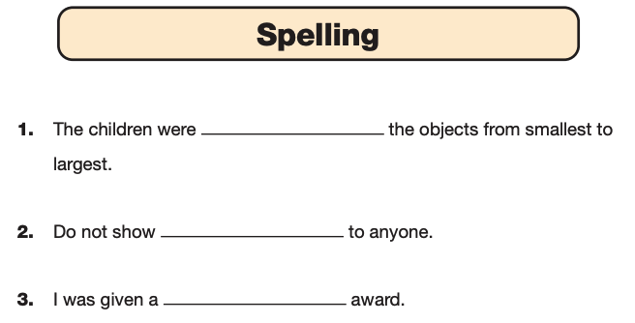
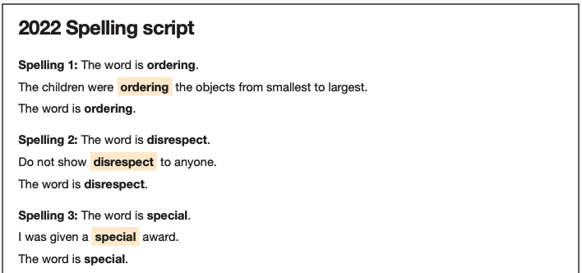
Grammar, Punctuation and Spelling: Paper 2 (spelling)
Monday
Paper 2 is a shorter paper that focuses solely on spellings – it is not a test of speed, we wait for all children to be ready before moving to the next spelling.
Example questions: Mixture of 3/4 and 5/6 spellings but not limited to them.
Notes:
There is a spelling script that accompanies this. Example:
The word is creature. The dragon is an imaginary creature. The word is creature.

Slide 9
Reading: Tuesday
There is one reading test that lasts for 60 minutes.
The test is designed to measure if the children’s comprehension of age-appropriate reading material meets the national standard. There are three different set texts for children to read. These could be any combination of non-fiction, fiction and/ or poetry.
The test covers the following areas (known as Content Domains):
Give/ explain the meaning of words in context;
Retrieve and record information/ identify key details from fiction and non-fiction;
Summarise main ideas from more than one paragraph;
Make inferences from the text/ explain and justify inferences with evidence from the text;
Predict what might happen from details stated and implied;
Identify/ explain how information/ narrative content is related and contributes to meaning as a whole;
Identify/ explain how meaning is enhanced through choice of words and phrases;
Make comparisons within the text.
We are NOT allowed to read any of the Reading paper test materials/questions to the children.

Slide 10
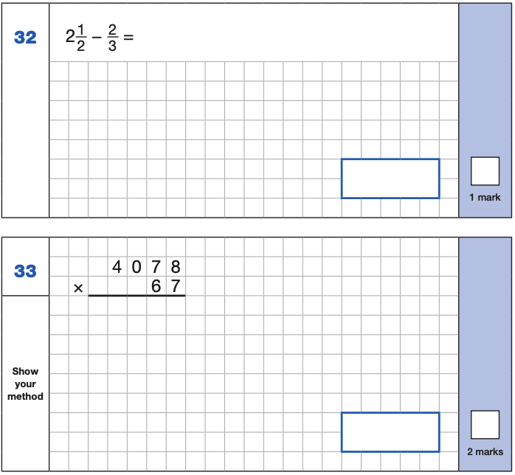
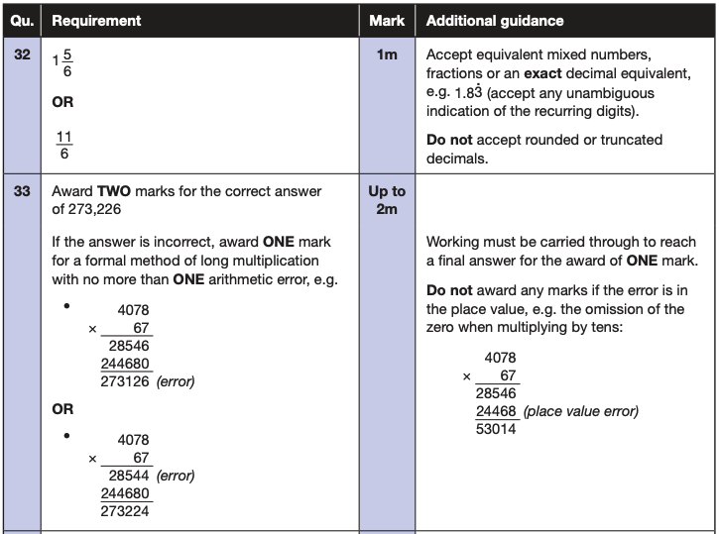
Maths Paper 1 out of 3 (Arithmetic) Wednesday
The maths arithmetic paper has a total of 40 marks and lasts for 30 minutes.
The test covers the four operations (addition, subtraction, multiplication, division, including order of operations requiring BIDMAS), percentages of amounts and calculating with decimals and fractions.
Example questions:
Notes:
Identify that there are some questions that have 2 marks and some that have 1.

Slide 11
Maths Papers 2 (Reasoning) Wednesday Maths Paper 3 (Reasoning) Thursday
These papers require children to demonstrate their mathematical knowledge and skills, as well as their ability to solve problems and use their mathematical reasoning. They cover a wide range of mathematical topics from key stage 2 including,
Number and place value (including Roman numerals);
The four operations;
Geometry (properties of shape, position and direction);
Statistics;
Measurement (length, perimeter, mass, volume, time, money);
Algebra;
Ratio and proportion;
Fractions, decimals and percentages.
We ARE allowed to read out questions to the children IF the children ask – please encourage them to do so as this is helps them to process the question.
Notes:
In general, the questions get progressively harder throughout the paper. As this is the case, it is not unusual for children to be unable to complete the entire paper in the given time.

Slide 12
Supporting your child in preparing for the SATs
Firstly, a positive attitude is key. Give them as much encouragement and support as you can (but we don’t need to tell you that)!
Tips and suggestions:
Don’t use past papers as they are used in school to prepare the children.
Encourage your child to talk to their teacher or a trusted adult (including yourself) about their anxieties. Don’t forget that a small amount of anxiety is normal.
Give your child a quiet, distraction-free space to complete homework or study.
Ensure your child is eating and drinking well and getting a good amount of sleep before the tests.
Keep revision light but regular. Going over the papers they have
completed at school is a great start. Times tables, real world mental maths as you are shopping or cooking is a good way to keep revision light.
Notes:
Encourage parents not to use past papers at home. If they want to use past papers with tutors, suggest that they could take copies of completed test home to work through with tutors. This may help them to work through specific misunderstandings.

Slide 13
What to do if you are worried about your child in the run up to SATs
Talk to the school
Sometimes concerns present at home and not at school. If you notice a change in your child, talk to the school so that everyone concerned can offer the support needed.
Talk to your child
Talk to your child about what aspect of SATs concerns them the most. If you can help them pinpoint what is bothering them the most, you can take specific steps to help reassure them.
Encourage your child to talk to their teacher
SATs are obviously linked to school. Don’t be surprised if your child would prefer seek reassurance from teachers over family members.
Try not to project your own anxieties or views about the SATs
As you know, children can be very intuitive. If they see that you are anxious,
this could add to their own anxieties. Similarly, if you don’t believe in SATs, your child may reflect this view.
Notes:
It may also be appropriate to discuss if there are any changes at home that could add stress to the child (e.g. moving house, a new sibling, recent bereavement).
There may be media coverage around the SATs, parents may want to discuss this with their children (positive or negative).

Slide 14
Mayhill Junior School Year 6 SATs 2024 Presentation for Parents, Carers & Guardians
Please feel free to stay to look at the example papers and to ask us any questions about SATs week.
This presentation will be saved on the website.

