Slide 1
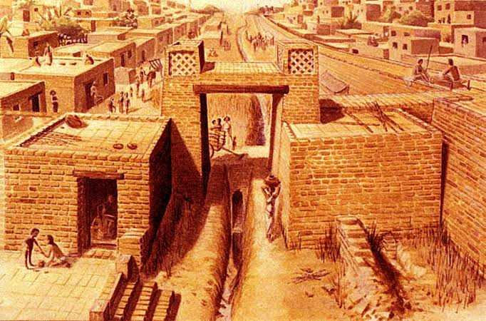
The Indus Valley
By the ~Indus Warriors~ (Grace, Lydia, James .N and Jimmy)
Notes:
James n: Our presentation is on the –indus valley- who are an ancient civilization.

Slide 2
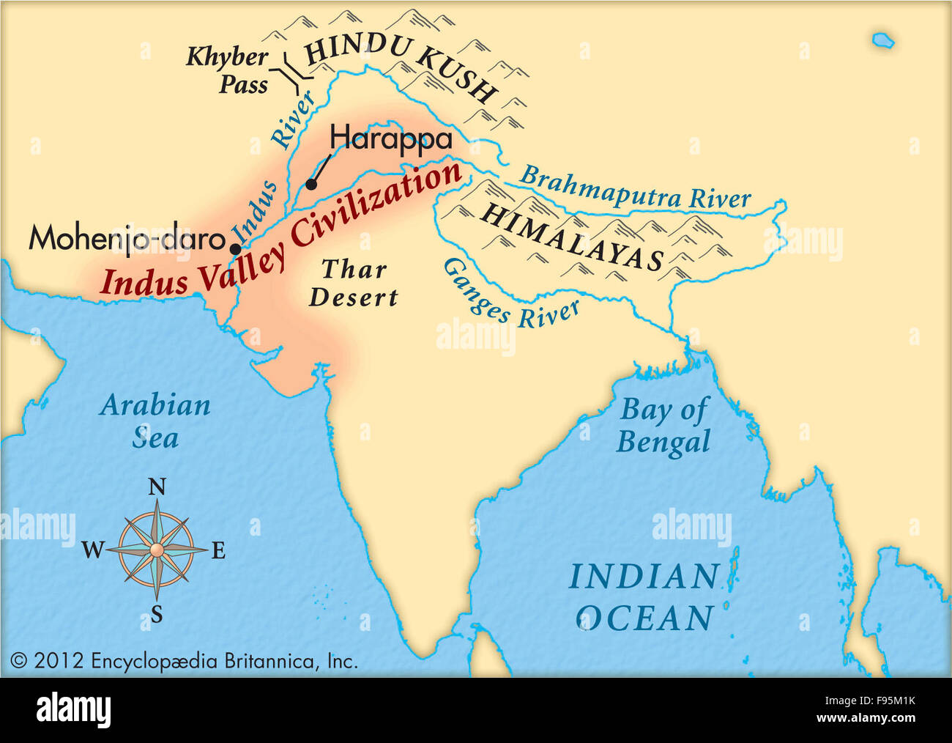
Where is the civilization based?
Are based in west India and Pakistan
lived in a hot and dry climate
The Indus tribe were based near the river Indus
The river Indus also attracts civilizations for transport and water
Notes:
JIMMY: the Indus valley are based in West India and Pakistan
Grace: the Indus valley had many floods due to how it is.
Lydia: Indus river supplied them water and many animals to hunt. The Indus river also attracts civilizations (Because of the water) Its also good for transport

Slide 3
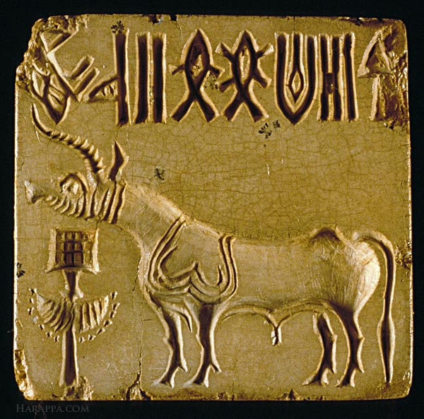
When and how did the Indus Valley start and end?
The Indus valley started in C.2600 BCE – C.1046 BCE
India’s first civilisation developed in the Indus Valley
The Indus Valley had no ruler
No-one knows how the Indus Valley ended
Notes:
Jimmy: The indus civilization started in C. 2600 BC – C.1046 bC
James: The Indus river system brings a steady source of irrigation water to the Indus valley that made farming in this dry region possible
cities like Mohenjo-Daro had a separate ruler
Grace: scientists have many theories why the civilization ended:
Lydia: Did Barbarians invade causing them to leave? Did Climate change make it too hot or dry? Was there a major earthquake causing everything to collapse?

Slide 4
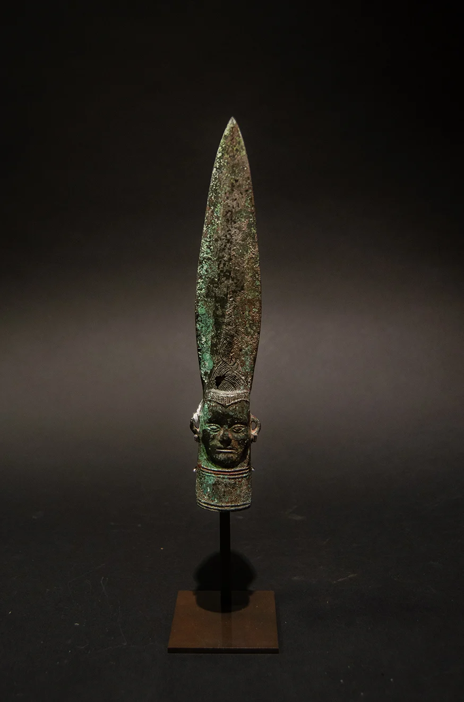
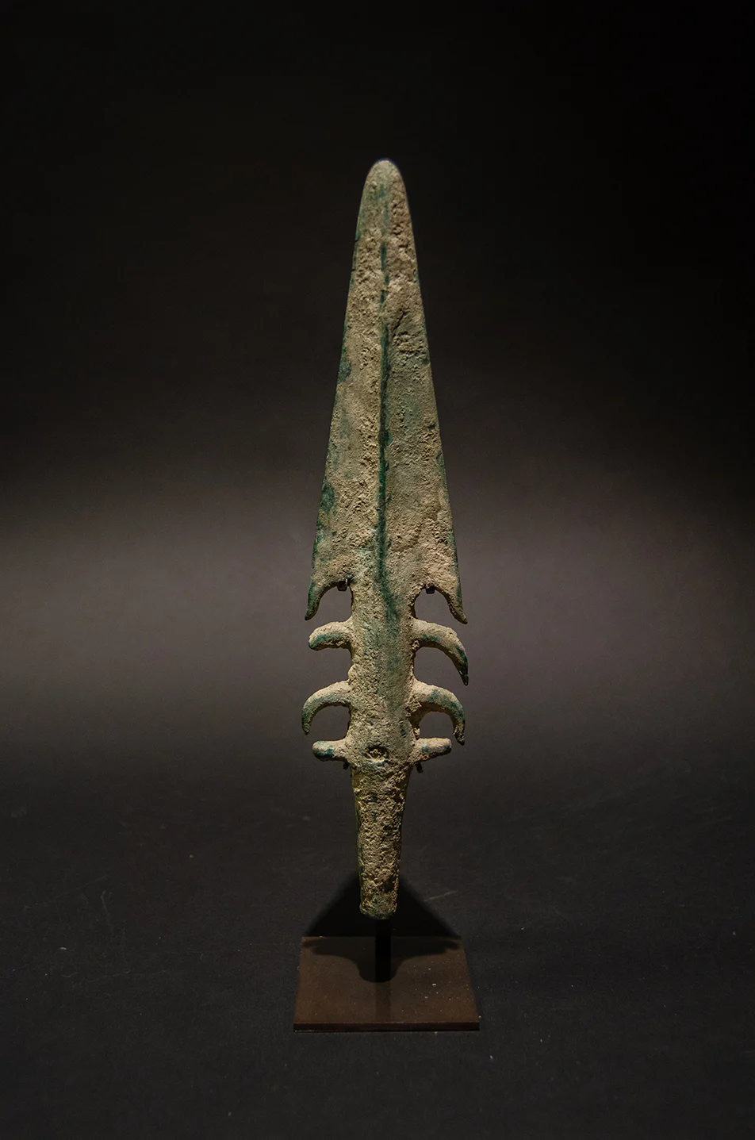
What skills and weapons did they have?
The Indus Valley cities were surrounded by strong walls and gates in case of conflict and floods from the Indus river.
The Indus Valley used leaf – shaped spears.
Indus Valley cities were divided into different zones for the ruling class and lower town for common people.
The Indus people were skilled.
The Indus civilization were peaceful and didn’t have many conflicts
Notes:
Jimmy: Other common weapons were short swords , daggers and axes all made of copper
James. N: They were skilled at craftsmen and farmers and were also very good at pottery.
Lydia: The indus valley civilization were very peaceful and didn’t have many conflicts. But in case of war, the cities were surrounded by strong walls and gates.

Slide 5
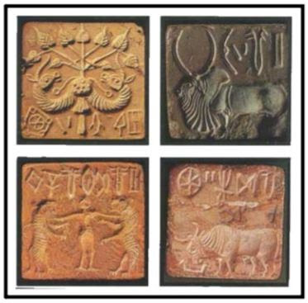
Were the civilization first to achieve anything?
The Indus tribe were first to grow and weave cotton cloths.
They also achieved: creating standardized weights and measure, seal carving, metallurgy with copper, bronze, lead and tin.
They are a larger civilization than the Egyptians
Notes:
Grace: The Indus tribe were the first to grow and weave cotton
Lydia: The Indus valley also achieved creating standardized weights and measure, seal craving (like the picture on here) Metallurgy (metal- lergy ( heres how to pronounce don’t actually say this in script) with copper, bronze, lead and tin.
Jimmy: They are a larger civilization (civee- lies- a- sh-on) than the Egyptians

Slide 6
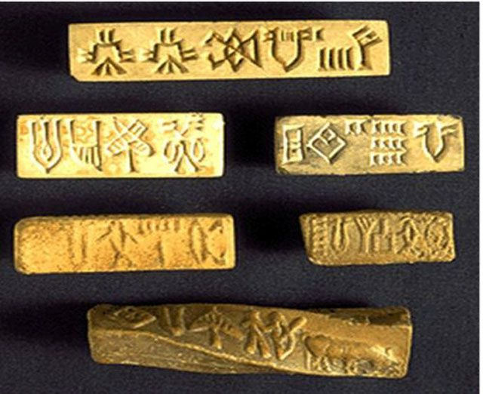
Why are they important in history?
It is important because if they hadn’t grown cotton, then we wouldn’t have cotton today.
The Indus valley rive provided fertile soil for growing crops of rice, wheat, various fruit and vegetable, and cotton.
Notes:
James.N: It is important because if the Indus didn’t grow cotton we might not have it today.
Jimmy: The Indus Valley river is important because it provide fertile soil for growing crops of rice, wheat, different fruits and vegetables and cotton

