Slide 1
Talk like the KBN Valley !
By:
Keyano, Beatrice and Nyla
Notes:
All of us say it in an Australian/ American accent.

Slide 2
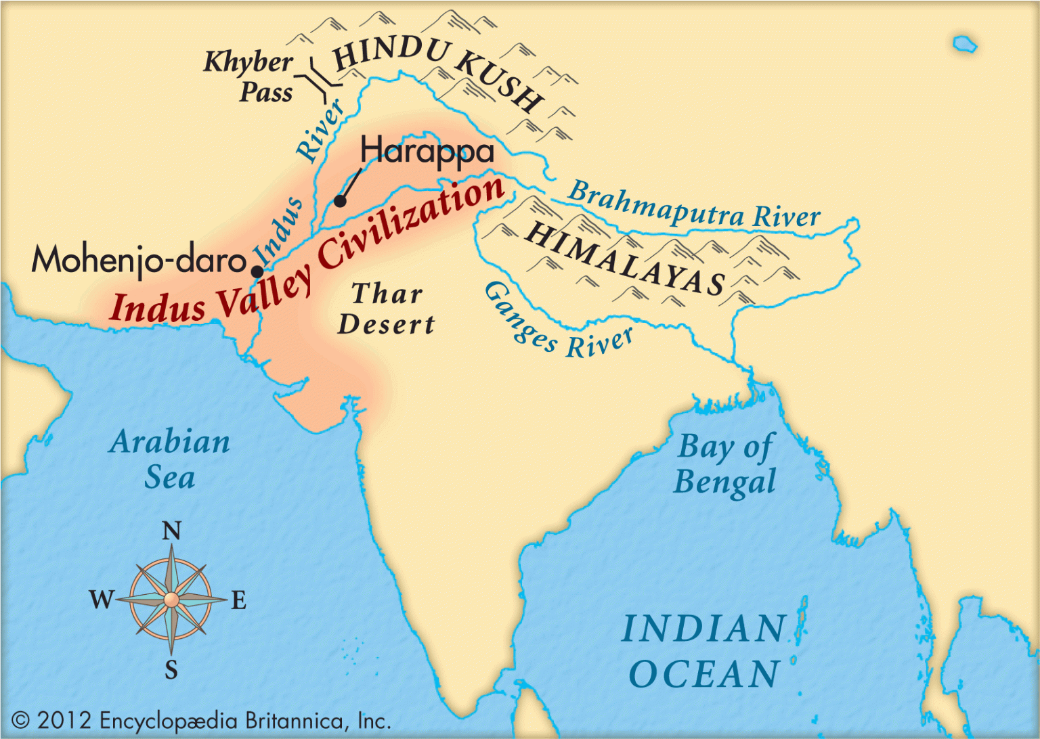
Where is the Indus Valley?
It is in what now is Pakistan and Western India
Alongside the Indus Valley is the Himalayas
The Indus Valley came to existence about 4500 years ago
It is very hot in the Indus Valley.
Notes:
Each of us say one of the paragraghs.
Alongside the Indus Valley is the Himalayas that is a major mountain. – Keyano says
The Indus Valley came to existence about 4500 years ago in what is now Pakistan and Western India. – Bea
It is very hot in the Indus Valley. Due to the hotness the Indus River – one of their major rivers -, which has many benefits but sometimes washes them away,
dried up around 4200 years ago. – Nyla

Slide 3
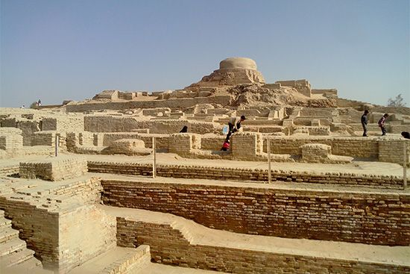
Intriguing Indus !
Their civilisation was bigger than the Egyptians
The Indus Valley declined around 1800 BC.
The use of the plough enabled many crops to be grown
The Anglo saxons where in charge of Brittan
It was a time of war, of the breaking up of Roman Britannia
Notes:
The Indus Valley ancient civilization declined around 1800 BC. – keyano
Irrigation and the use of the plough enabled many crops to be grown. Their civilisation was bigger than the Egyptians -
Bea says
During this time the Anglo saxons where in charge of Brittan. It was a time of war, of the breaking up of Roman Britannia into several separate kingdoms, of religious conversion and, after the 790s, of the continual battles against the new set of invaders: The Vikings – Nyla

Slide 4
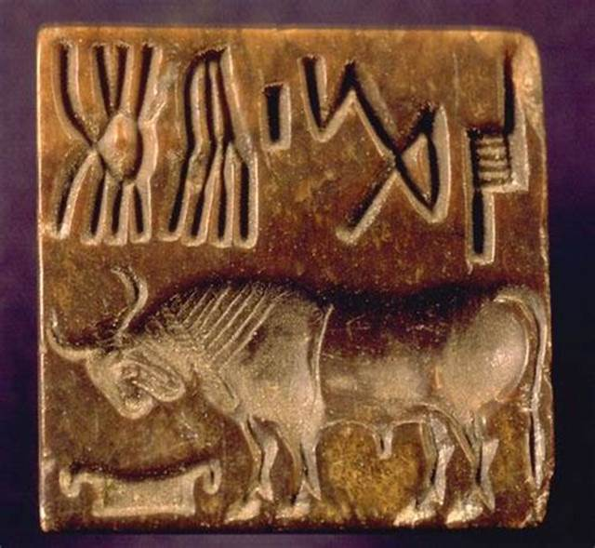
Fantastic Facts
They had uncovered evidence of the use of “practical mathematics”.
They used potter wheels to make most clay items.
The Indus Valley invented a form of writing.
Gold ,copper, silver and bronze metals were know to Indus Valley.
People would not like to buy things without seals
The Indus Valley had spears with thin leaf-shaped spearheads.
Notes:
They used potter wheels to make most clay items.-Keyano says
One about wrighting /maths and metals Bea says
Nyla says- The Indus Valley had spears with thin leaf-shaped spearheads.
People would not like to buy things without seals (they are like logos’s ).
Bea says - Gold ,copper, silver and bronze metals were know to Indus Valley. The had not discovered iron.
The Indus Valley invented a form of writing. Generally right to left. They had uncovered evidence of the use of “practical mathematics”.

Slide 5
Fabulous Firsts !
They were the first to create sewers
Did you know?
The Indus Valley built some of the first plans for cities ever.
Some of the first Dentists came from the Indus Valley!
In the Indus Valley they created dice.
The people in Indus Valley, were the first to grow cotton and weave cotton clothes.
They were the first big gamers
During the Indus Valley period there was an increase of terracotta carts and wheels.
Notes:
Keyano says - They were the first to create sewers for wastage. In the Indus Valley they created dice.
. Nyla says - The people who lived in the Indus Valley, were the first to grow cotton and weave cotton clothes. The Indus Valley people built some of the first plans for cities ever.
.. Bea says - During the Indus Valley period there was dramatic increase of terracotta carts and wheels. They were big gamers ( they created dice ) in the Indus Valley. They loved to dance and preform. The Did you know

Slide 6
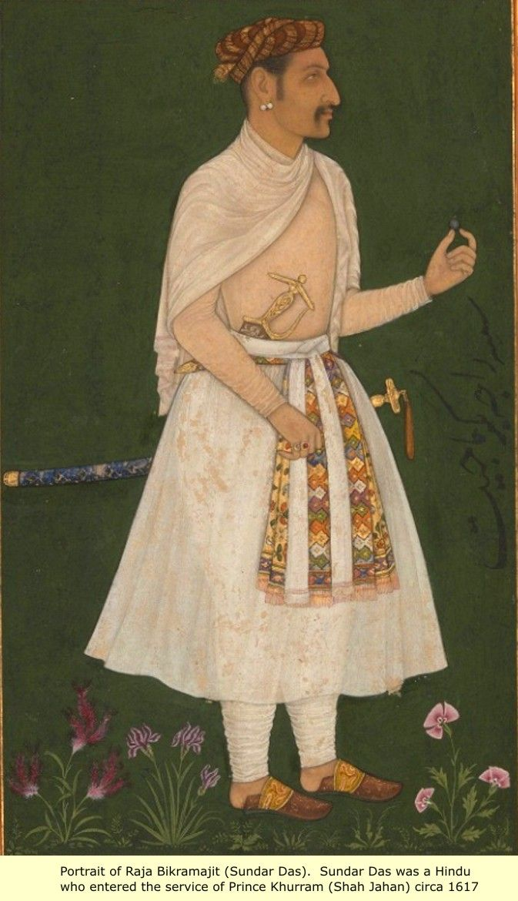
Day to Day life !
The artist and craftsmen of the Indus Valley were extremely skilled
Their main food was Wheat and Barley
The women wore a type of skirt and a shawl around their shoulders.
Men and Women, both rich and poor, wore necklaces, fillets ,armlets and finger rings and were common to both women and men.
In the Indus Valley they still had 12 months but they had 354 days a year.
Notes:
Keyano says- In the Indus Valley they still had 12 months but they had 354 days a year. Every 30 months they would add and extra month a year.
. Nyla says - The women wore a type of skirt and a shawl around their shoulders. Men and Women, both rich and poor, wore necklaces, fillets ,armlets and
finger rings and were common to both women and men. These were made of gold, silver, copper, bronze, Ivery and shells. Bea says- The artist and craftsmen of the Indus Valley were extremely skilled in a variety of crafts-metal casting, stone carving, painting pottery and making and making terracotta images using simplified motifs of animals, plants and birds.
Nyla says - Their main food was Wheat and Barley, but they also ate peas, chickpeas, green gram and black gram

Slide 7
We shall be remembered!
Notes:
Nyla - In the Indus River Valley civilization they were considered as one of the most important sources
Keyano - as the Indus river provided water for the cultivation and trading of goods internationally.
Bea - 10% of the world’s total population lived in the ancient civilisation of the ancient civilisation of the Indus Valley.

