Slide 1
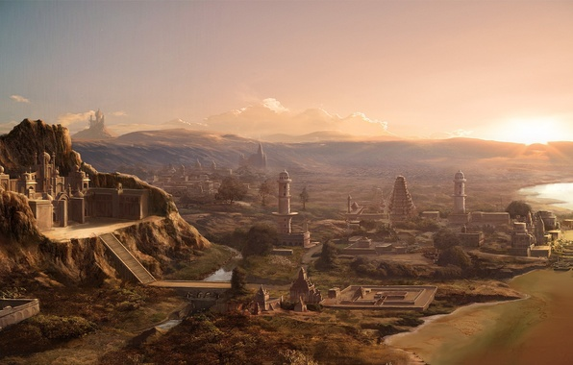
The Sumer Warriors
By Lizzy, James and Arthur
Notes:
Lizzy: Welcome to our PowerPoint. We are the Sumer Warriors

Slide 2
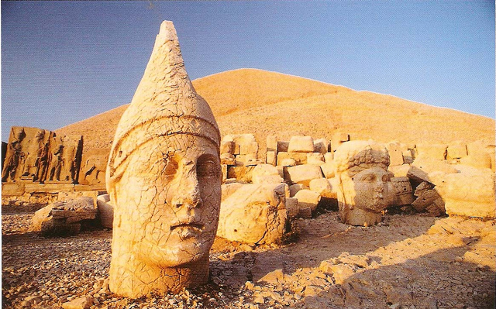
Where in the world?
The ancient Sumer was in modern Iraq.
The climate is quite strange because it can flood but its really hot when its not flooded.
There are two major rivers around ancient Sumer area which are the river Tigris and Euphrates.
Notes:
Arthur: Did you know? The main cities of the Sumer area are Eridu, Nippur, Kish and Umma and Eridu is thought to be the oldest city made by the ancient Sumerians.

Slide 3
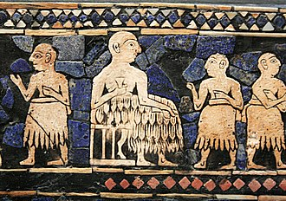
The start and end
Ancient Sumer was around from 5300BC all the way to 1940BC that’s more than 3000 years!
The population ranged from 800,000 to 1,500,000.
The ruler of ancient Sumer was Lugul (It stands for king ruler.)
Notes:
The start and end
Arthur; Ancient Sumer was around from 5300BC all the way to 1940BC that’s more than 3000 years!
The population ranged from 800,000 to 1,500,000.
James; The ruler of ancient Sumer was Lugul (It stands for king ruler.)

Slide 4
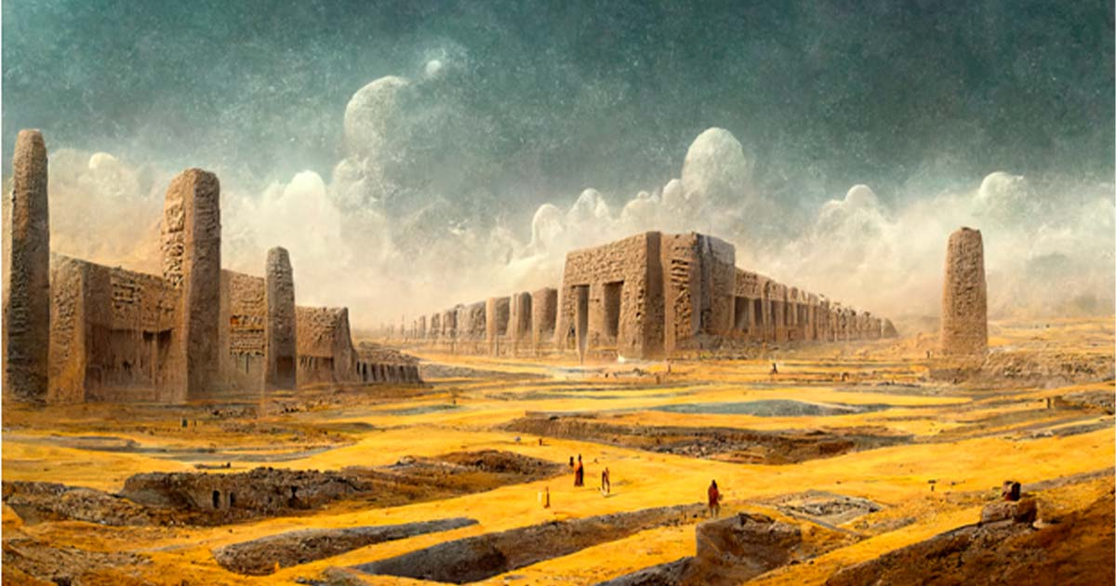
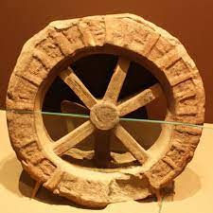
Knowledge, technology and skill
The Sumer people made jewellery and wore sheepskin skirts and dresses, called kaunakes.
The Sumerians created the wheel, which was originally stone but was later change to wood due to the weight of it, and it was used as a mode of transport.
They are one of the smartest tribe in Iraq/Iran.
They created the national language around the world.
Notes:
Knowledge, technology and skill
James; The Sumer people made jewellery and wore sheepskin skirts and dresses, called kaunakes.
The Sumerians created the wheel, which was originally stone but was later change to wood due to the weight of it, and it was used as a mode of transport.
Arthur; They created the national language around the world
Lizzy; They are one of the smartest tribe in Iraq/Iran.
They created the national language around the world.

Slide 5
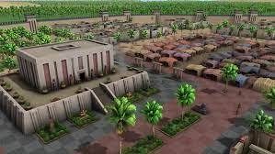
The first
They were the first at making the wheel, cuneiform script, arithmetic, geometry, irrigation, saws and other tools, sandals, chariots, grapple capable, and beer.
Notes:
The first
Lizzy; They were the first at making the wheel, cuneiform script, arithmetic, geometry, irrigation, saws and other tools, sandals, chariots, grapple capable, and beer.

Slide 6
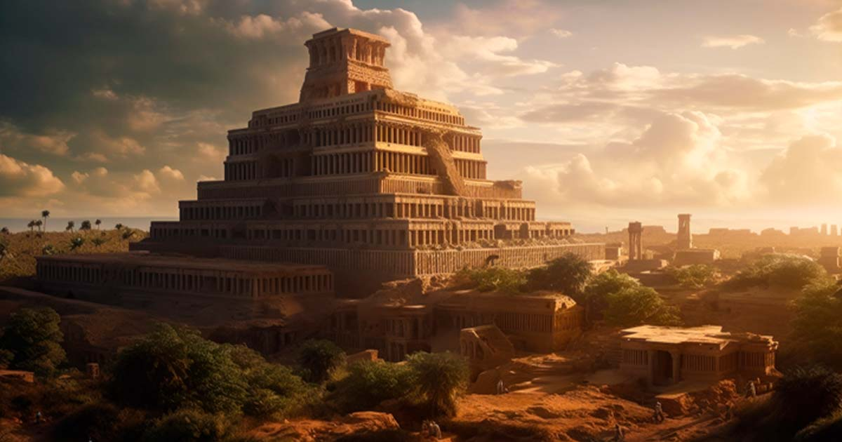
We will remember their history
They were place in ancient Iraq.
4200 years ago they created the wheel, writing and chariots.
Their favourite food is pig fat and they eat 4 jars it a day.
They made the script in the southern of Iraq.
They’ve built cities villages and towns.
Their know for building 3D models.
They love making pictures and decorating.
Notes:
All: remember!
James; They were place in ancient Iraq.
Arthur;4200 years ago they created the wheel, writing and chariots.
Lizzy; Their favourite food is pig fat and they eat 4 jars it a day.
James; They made the script in the southern of Iraq.
Arthur; They’ve built cities villages and towns.
Lizzy; Their know for building 3D models.
James; They love making pictures and decorating.

