Slide 1
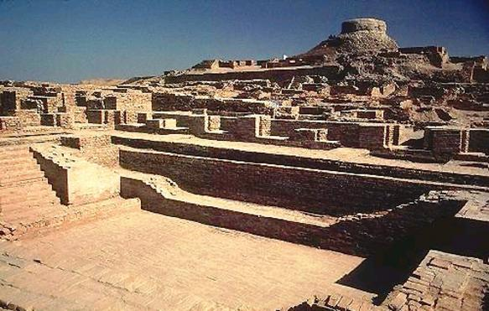
ALL ABOUT THE INDUS VALLEY
The Indus Pals: Amber, Phoebe, Leo and Jacob
T
Notes:
Leo

Slide 2
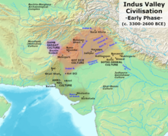
Climate! Where in the world?
heavy rain or monsoons
The monsoons seem to have gradually moved East and people have followed
earthquake caused one of the major rivers
Notes:
Leo: River Indus runs through the Indus Valley, which is in the subtropics. The Indus Valley covered half a million square miles from the Indian ocean to the foothills of the Himalayas. The people were dependant on the heavy rain or monsoons.
The monsoons seem to have gradually moved East and people have followed.
Another suggestion is that an earthquake caused one of the major rivers.

Slide 3
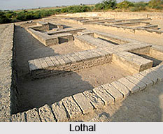
WHEN It All Began!
the worlds oldest ploughed fields
to date back as far as 3300 BC
reached it’s peak around 2600 BC
went to decline around 1900 BC
Notes:
Phoebe: Indus Valley came into existence about 4500 years ago in what is now Pakistan and western India. The Indus Valley civilization was discovered in the early 1900’s by a British archaeologist named Jhon Marshall. Since then, archaeologists have uncovered more and more evidence of the ancient culture. The Indus valley can be traced back to 7000 BC.

Slide 4
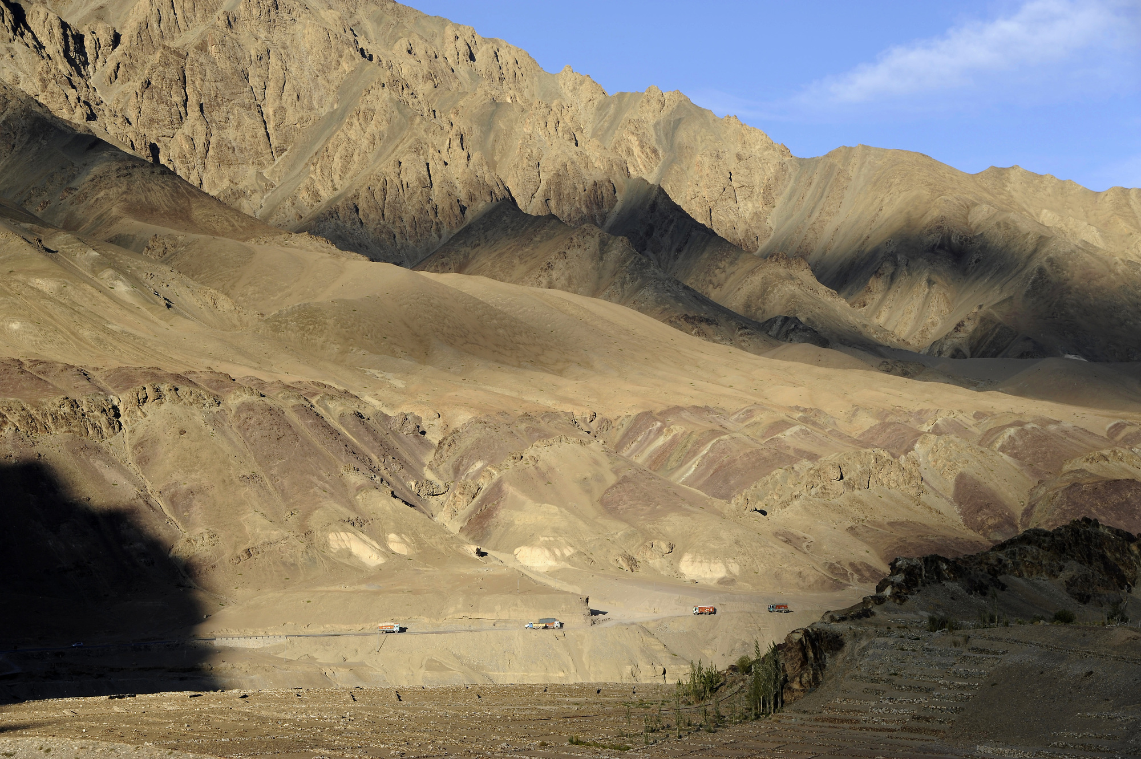
What did they develop?
there were skilled craftsman who worked with metals and clay, hunters ,fishermen , builders and scribes,
the Indus Valley were the first to grow cotton and weave cotton cloth,
Notes:
Amber: The citizens of the Indus Valley usually carried spears with leaf shaped heads. They tended to use gold, copper, silver and bronze. Children in the Indus Valley played with toys made of terracotta pottery. The oldest dice in the world was found at Harappa. They enjoyed crafting pottery ! Although most people lived by farming, there were skilled craftsman who worked with metals and clay, hunters ,fishermen , builders and scribes,
The people who lived in the Indus Valley were the first to grow cotton and weave cotton cloth,
Only a limited number of weapons have been recovered and there is little evidence of conflict. They used irrigation canals to bring water from the river to crops. By 2600 BCE, small early Harrapan communities have developed into large urban centres . Excavations at Harappa , Mohenjo-Daro and other sites of the Indus Valley civilisation have uncovered the use of “ practical mathematics.” The Indus Valley citizens mainly created sculptures and not much litature.

Slide 5
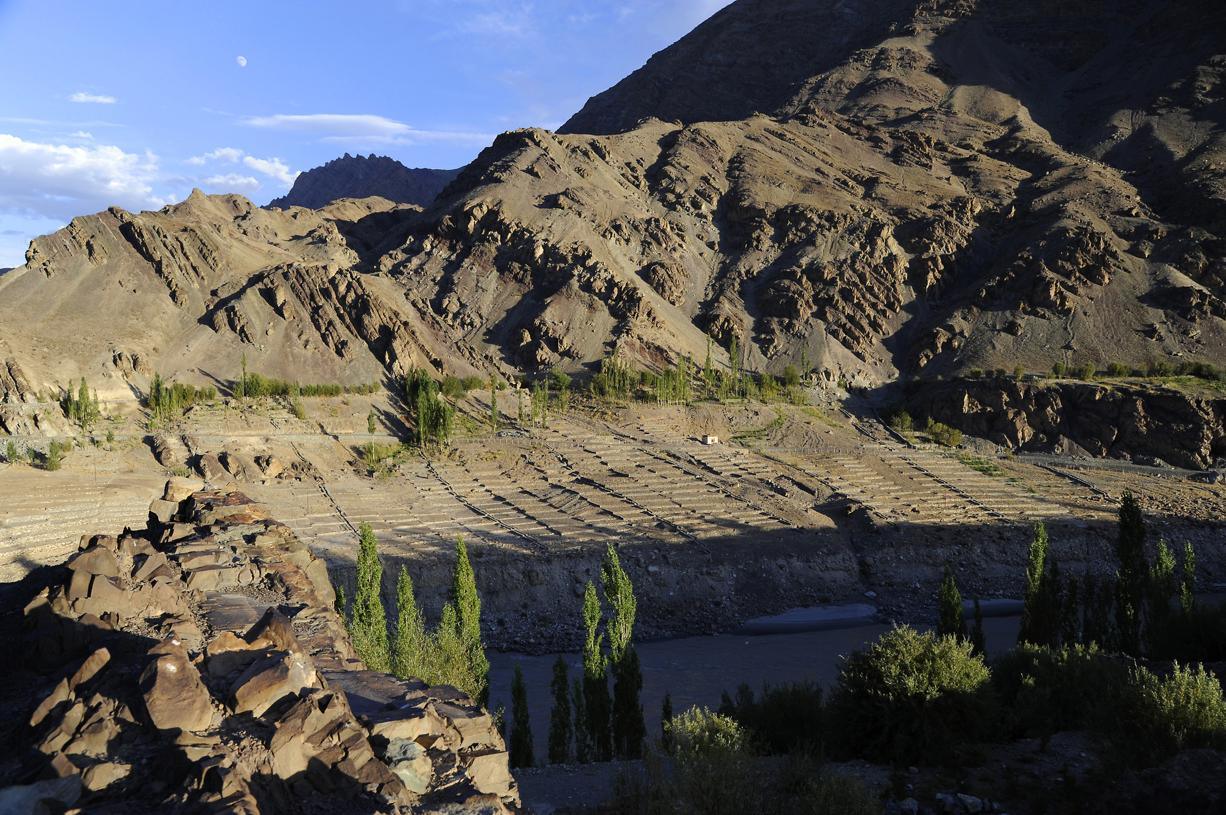
What did they achieve?
One of the worlds greatest civilization,
Largest of the early Bronze age civilizations,
Baked brick houses , urban planning and water supply systems
Notes:
Phoebe: Due to its location , Indus Valley was placed on a fertile plain and helped a lot in agriculture. Indus Valley developed the first accurate system of weights and measures. Indus Valley is rather important to the economy of the region. During the Indus Valley period , there was a dramatic increase in number of terracotta carts and wheels. The wheel – throwing technique was consistently used to make many vessels. The Indus valley created a form of writing .

Slide 6
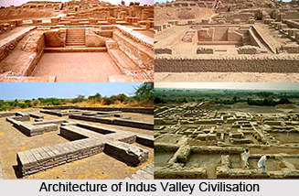
Significant In History
The Indus Valley was one of the first greatest civilizations. Indus Valley was the largest of the early bronze age civilizations . Citizens who lived near the River Indus were the first to grow cotton and weave cotton cloth . In Harappa the oldest dice was found ! The temperature is perfect for anyone ,due to the fact it is in the subtropics . The Indus Valley civilisation will be remembered by us today and forever!
Notes:
Amber

