Slide 1
The Egyptians
Pech
Notes:
Hello we are the Egyptians and we will be doing a presentation on what was happing in Ancient Egypt

Slide 2
Egypt
The Ancient Egyptians lived in a very dry and arid place in Africa that they named Egypt.
They had a Major river which they used for, Hunting and Trading, with other civilisations and Farming e.g.
On the other side of the river Nile there is a place the Egyptians called ‘the Black Land.
Notes:
The Ancient Egyptians lived in a very dry and arid place in Africa that they named Egypt. They had a Major river which they used for :Hunting; Trading, with other civilisations and Farming e.g. On the other side off the river Nile there is a place the Egyptians called ‘the Black Land’ A narrow strip of the fertile soil.

Slide 3
The birth and death of Egypt
In 3000BCE the independent city states off Egypt where discovered by the Egyptians they also Find out how to make linen from flax paper.
During 3100 BCE in Britain it was the Bronze Age but in the south east Egypt was doing a lot more.
They made lots of discoveries around medicine and can treat medical burns . The creative Egyptians are still around to this day!
Notes:
In 3000BCE the independent city states off Egypt where discovered by the Egyptians and they thrived by the River Nile growing continually by discovering how to make linen from flax paper and made it into: Rope platted it together to make boat’s ,baskets and sandals.
They also made lots of discoveries around medicine and how it works .They also no a healthy pulse and can treat medical burns . The Egyptians are still around to this day!

Slide 4
There Amazing Brains!
Ancient Egypt achieved a relatively high standard.
They also use hieroglyphics as there form of writing and recording notes
The Ancient Egyptians invented a Synthes to help them harvest crops.
The Egyptians developed a number system.
Notes:
In technology, medicine, and mathematics, ancient Egypt achieved a relatively high standard of productivity and sophistication. They also use hieroglyphics as there form of writing and recording notes The Ancient Egyptians invented a Synthes to help them harvest crops. The Egyptians developed a number system that used different symbols to show units, tens and hundreds

Slide 5
First accomplishments DID YOU KNOW
Egyptians were the first civilization to make paper-like martyrial. They where also the first to invent pyramids.
Egypt was one off the most import and advanced cultures in the world!
Notes:
Egyptians were the first civilization to make paper-like martyrial. They where also the first to invent pyramids which where VAST. For almost 30 centuries Egypt was one of the most import ant and advanced cultures in the world!

Slide 6
Why They Rule
We think Egyptians should be remembered in History because they are creative and influenced modern life humans because they are so intelligent and smart they discovered many things that we use to this day.
Notes:
We think Egyptians should be remembered in History because they are creative and influenced modern life humans because they are so intelligent and smart they discovered many things that we use to this day.

Slide 7
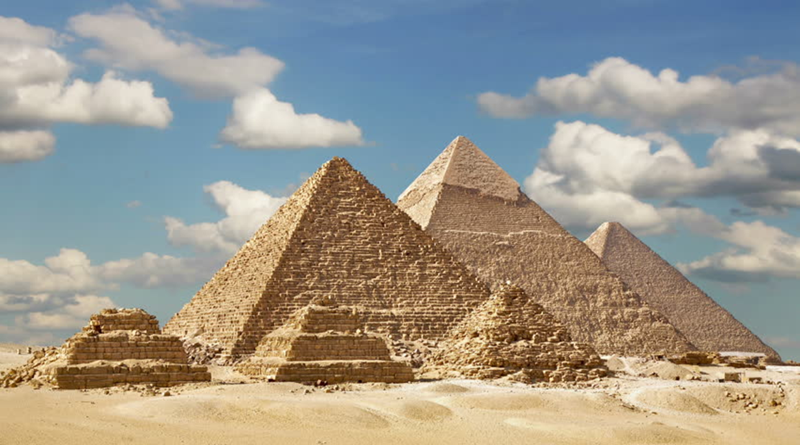
Presented by Harriet, Cara, Patryk and Euan
Thank you for watching our presentation
Notes:
Thank you watching are presentation we hope you now a bit more about Ancient Egypt your well come

