Slide 1
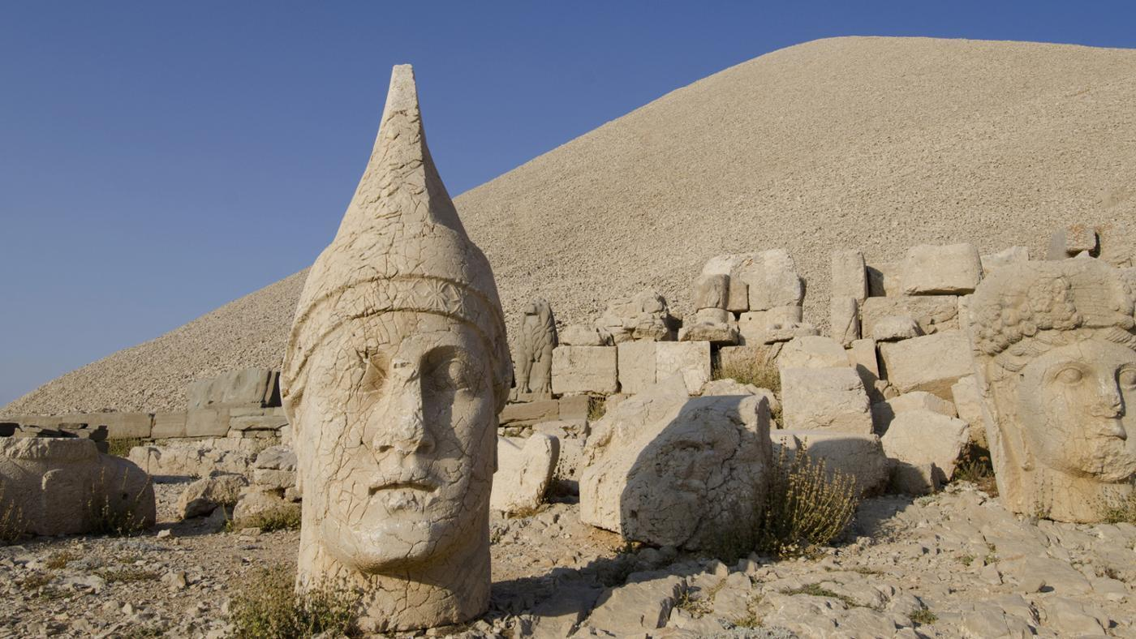
THE ANCIENT SUMERS
By Delilah, Amelie and Cayden
This Photo by Unknown Author is licensed under CC BY-SA-NC
Notes:
Delilah : The ancient Sumers.
Amelie: by Delilah Amelie and Cayden.

Slide 2
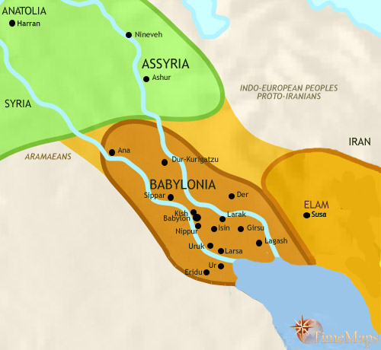
Where was the Sumer Civilisation?
Iraq, Northern Hemisphere.
Subtropics
Tigris river and Euphrates river.
This Photo by Unknown Author is licensed under CC BY-SA-NC
Notes:
Cayden : The sumers lived in modern Iraq and had a very hot and dry climate. Its is in the Northern Hemisphere.
Delilah: It was a very hot country ( it was in the subtropics ).
Amelie: The biggest rivers in Iraq are the Tigris river and Euphrates river.

Slide 3
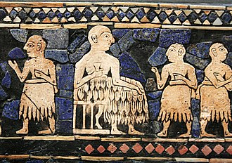
When did the civilisation start?
c5300BC –c1940bc.
The Sumer there was stone age in England.
The king (Ghazi).
This Photo by Unknown Author is licensed under CC BY-SA
Notes:
Cayden: The ancient Sumer lasted until c5300BC-c1940BC. the Ancient Sumer was for 3360 years
Amelie: Whilst there was the Sumer there was stone age in England.
Delilah: The leader of Sumer was the king Ghazi

Slide 4
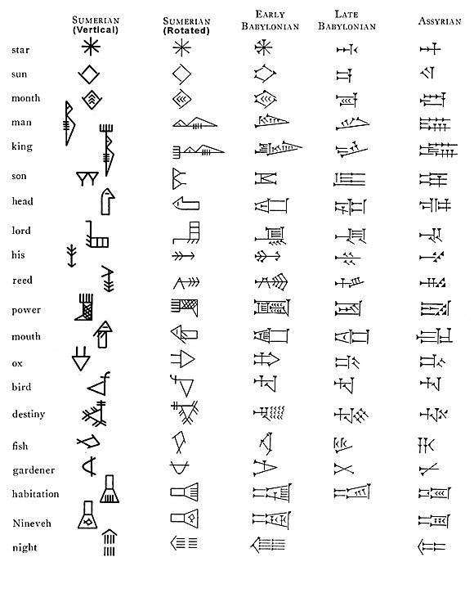
What did they make?
Ziggurats, arches and domes.
Gold, silver, bronze and copper.
They loved playing music and listening to it.
Special Sumerian script.
This Photo by Unknown Author is licensed under CC BY-SA
Notes:
Cayden: Craftsmen produced a range of golds, silvers, bronze and coppers and minutes were called units in the Ancient Sumer.
Amelie: They loved playing music and had a special Sumerian script
Delilah: They also loved making music.

Slide 5
What they used.
( Pottery ) wheel.
Arithmetic, geometry, irrigation, saws, sandals
, chariots, harpoons and beer.
Mathematics on clay tables.
This Photo by Unknown Author is licensed under CC BY-SA
Notes:
Delilah: The Sumerians where first to invent the pottery wheel
Cayden: They made/improved lots of things like arithmetic, geometry, saws, sandals and more and did mathematics on clay tables

Slide 6
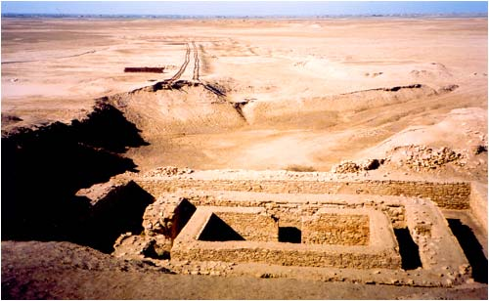
What will they be remembered as.
This is the best civilisation because the Sumerian made and improved lots of stuff and made a big Sumerian script. They also made music.
This Photo by Unknown Author is licensed under CC BY-NC-ND
Notes:
Amelie: This is the best civilization because the sumerians made and improved lots of stuff and made a big Sumerian script.
Cayden: They also made music to listen to.

