Slide 1
Super Super Sumer
By Ben, Ruben, Faye and Saskia
We are doing a presentation about the Ancient Sumer's

Slide 2
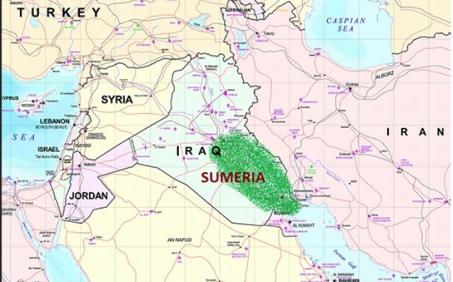
Where were the ancient Sumer’s based ?
Ancient Sumer was sighted in the east of an area referred to as ‘the fertile crescent’ which was part of a larger area: Mesopotamia
Sumer’s lived from around 5,000-2,350 BC
Located between Tigris and Euphrates rivers

Slide 4
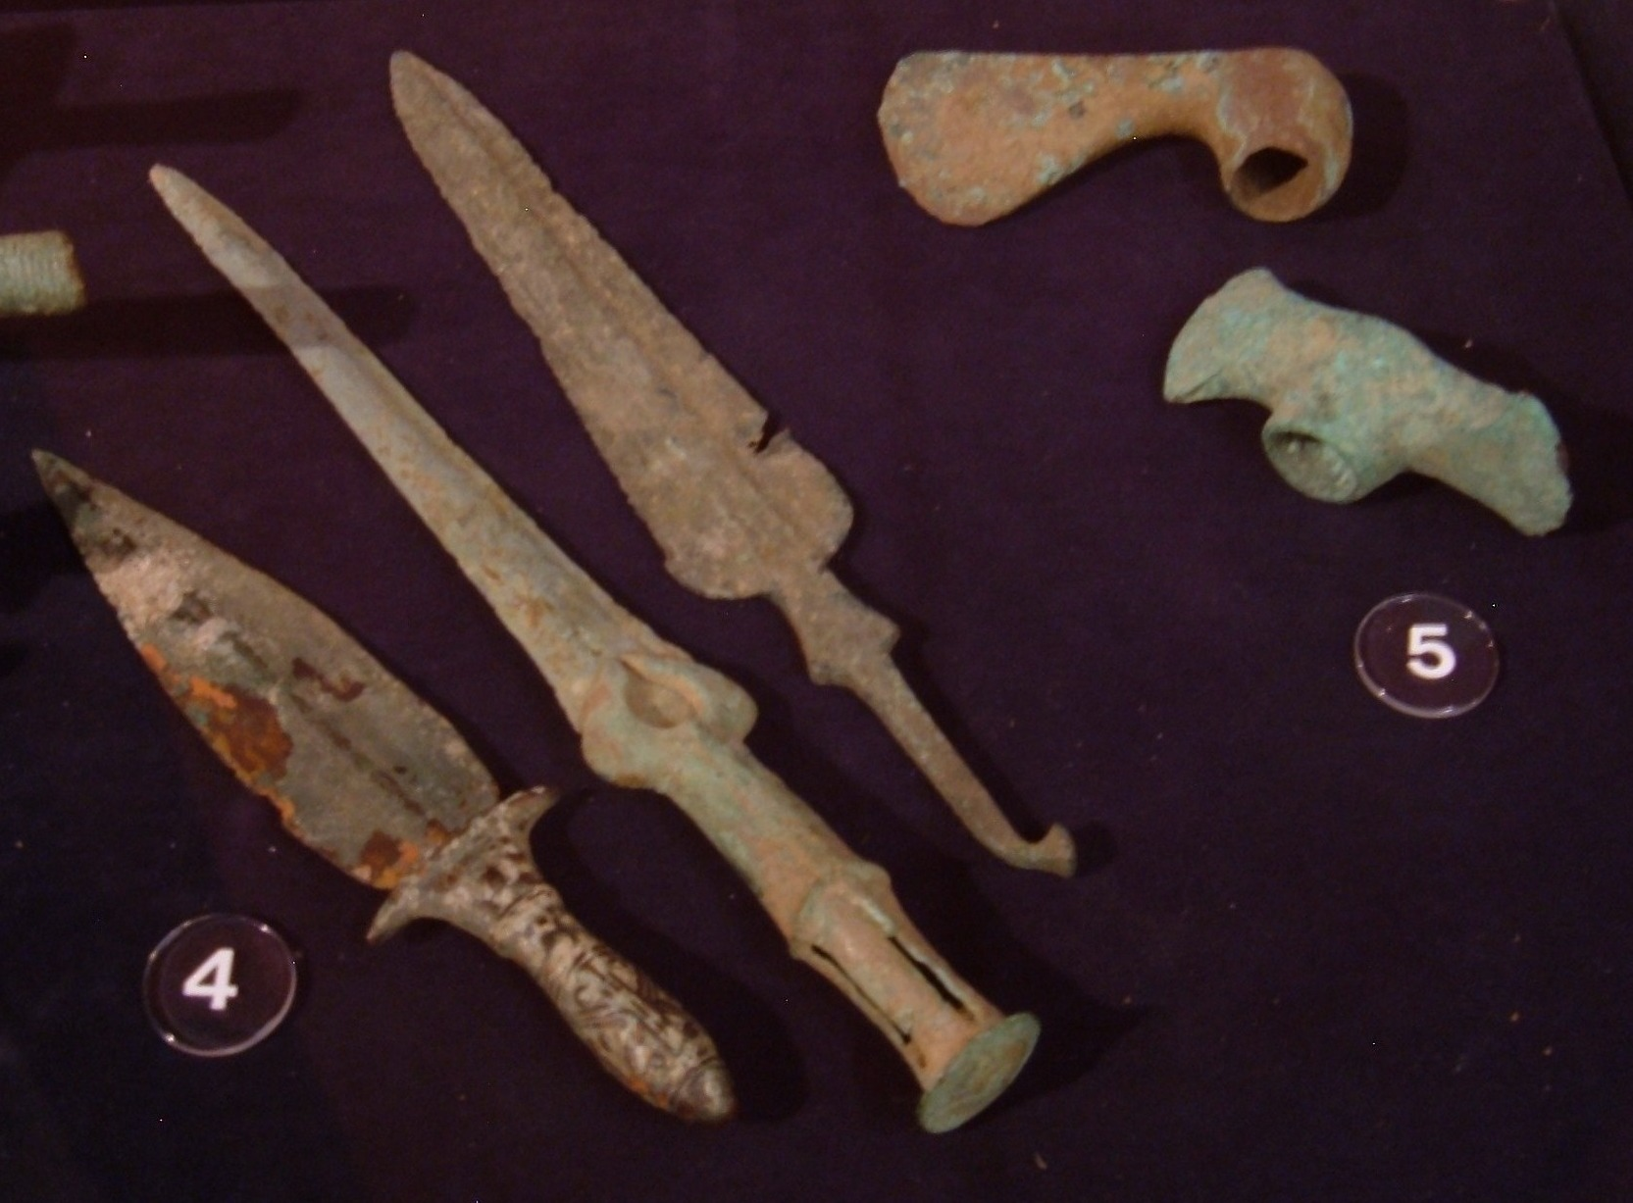
What did the Ancient Sumer build?
The Ancient Sumer made the 60 minute clock they also built boats, carts and chariots to get around. They made weapons such as:
Axes
Spears
Bows and arrows
Swords
Sickle Swords
Maces
Adzes
Hoes
This Photo by Unknown Author is licensed under CC BY-SA
Notes:
The Ancient Sumer made the 60 minute clock they also built boats, carts and chariots to get around. They made weapons such as bows and arrows, spears , swords and Hoes.

Slide 5
Where they the first to make anything?
They were actually the first to invent the wheel.
Notes:
They were the first to invent the wheel even though you may have been told the Egyptians did

Slide 6
Questions?
Did they use potters wheels? Yes they did, they invented the potters wheel!
Did they have a form of writing? They made the earliest form of writing called cuneiform.
Did they build cities? They built villages, towns and cities.
Did they use mathematics? Yes
Did they measure time in some way? Yes, they used a complex system

Slide 7
Are the Ancient Sumer's the best civilization?
The Sumer's are the best civilization because they were very good at writing, making laws and science. They had a flair for innovation. They made the wheel and if they didn't the it probably wouldn’t exist.
Notes:
The Ancient Sumer made the 60 minute clock they also built boats, carts and chariots to get around.

