Slide 1
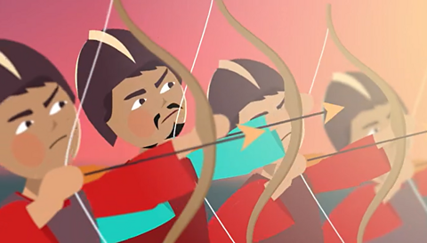
Shang Royals
Group: Molly, Ava, JT
About Shang Dynasty

Slide 2
Where ??
Shang Dynasty was based in China
The average temperature was 10°c
Mount Dai (Popular mountain)
The rivers such as Yangzi river and the Yellow river were the best to visit
They had lots of cities built out of mud and wooden beams and also surrounded by mud walls for defence
A large irrigation scheme was constructed to bring water to the crops from the Yellow river
Their main cities were Anyang , Zhengzhou and Loayang
Notes:
Molly: This slide shows where everything was located, such as , where the Dynasty first started and where all of their most popular destinations were to visit .
JT: Their cities were built out of mud and wooden beams an also surrounded by mud walls for defense .
Molly Shang dynasty was based in China , the average temperature was 10 degrees, mount Dai was the most popular mountain to visit
JT: The rivers such as the Yangzi river and the yellow river were the best to visit, they had lots of cities build out of mud and wooden beams and also surrounded by mud walls for defense
Molly a large irrigation scheme was constructed to bring water to the crops from the yellow river their main cities were Anyang , Zhengzhou and Laoyang

Slide 3
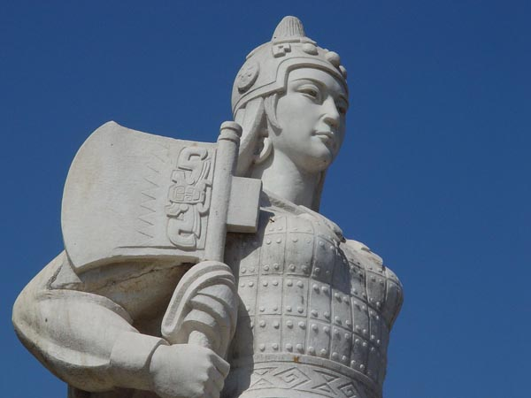
When?????
The Shang Dynasty started in 1600BC and ended in 1050BC that means it lasted for 600 years!!
Lady Fu Hao was a Shang Dynasty queen and military leader and led an army of over 10,000 men however, died in 1200BC
Notes:
Ava: At the same time as the Shang Dynasty the bronze age was happening in Great Britain.
JT: They also decided to move their Capital city to Yin other than Shang
Molly: which is in modern day Anyang
JT: The Shang Dynasty started in 1600BC and ended in 1050BC that means it lasted for 600 years!!
Molly : Lady Fu Hao was a Shang Dynasty queen and military leader and led an army of over 10,000 men however, died in 1200BC

Slide 4
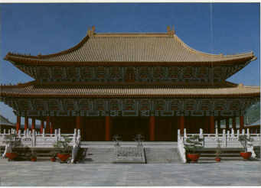
Skills
They were amazing at building homes and getting recourses
Bronze age was happening at the same time in Britain
Jade, Bronze, Stone, and woven
Their weapons were made out of stone and bronze
Notes:
Ava: the Shang Dynasty were very creative as they could build almost an out of stone, bronze wood and metal.
JT : They were amazing at building homes and getting recourses
MOLLY: Bronze age was happening at the same time in Britain
JT : Jade, Bronze, Stone, and woven
Ava : Their weapons were made out of stone and bronze

Slide 5
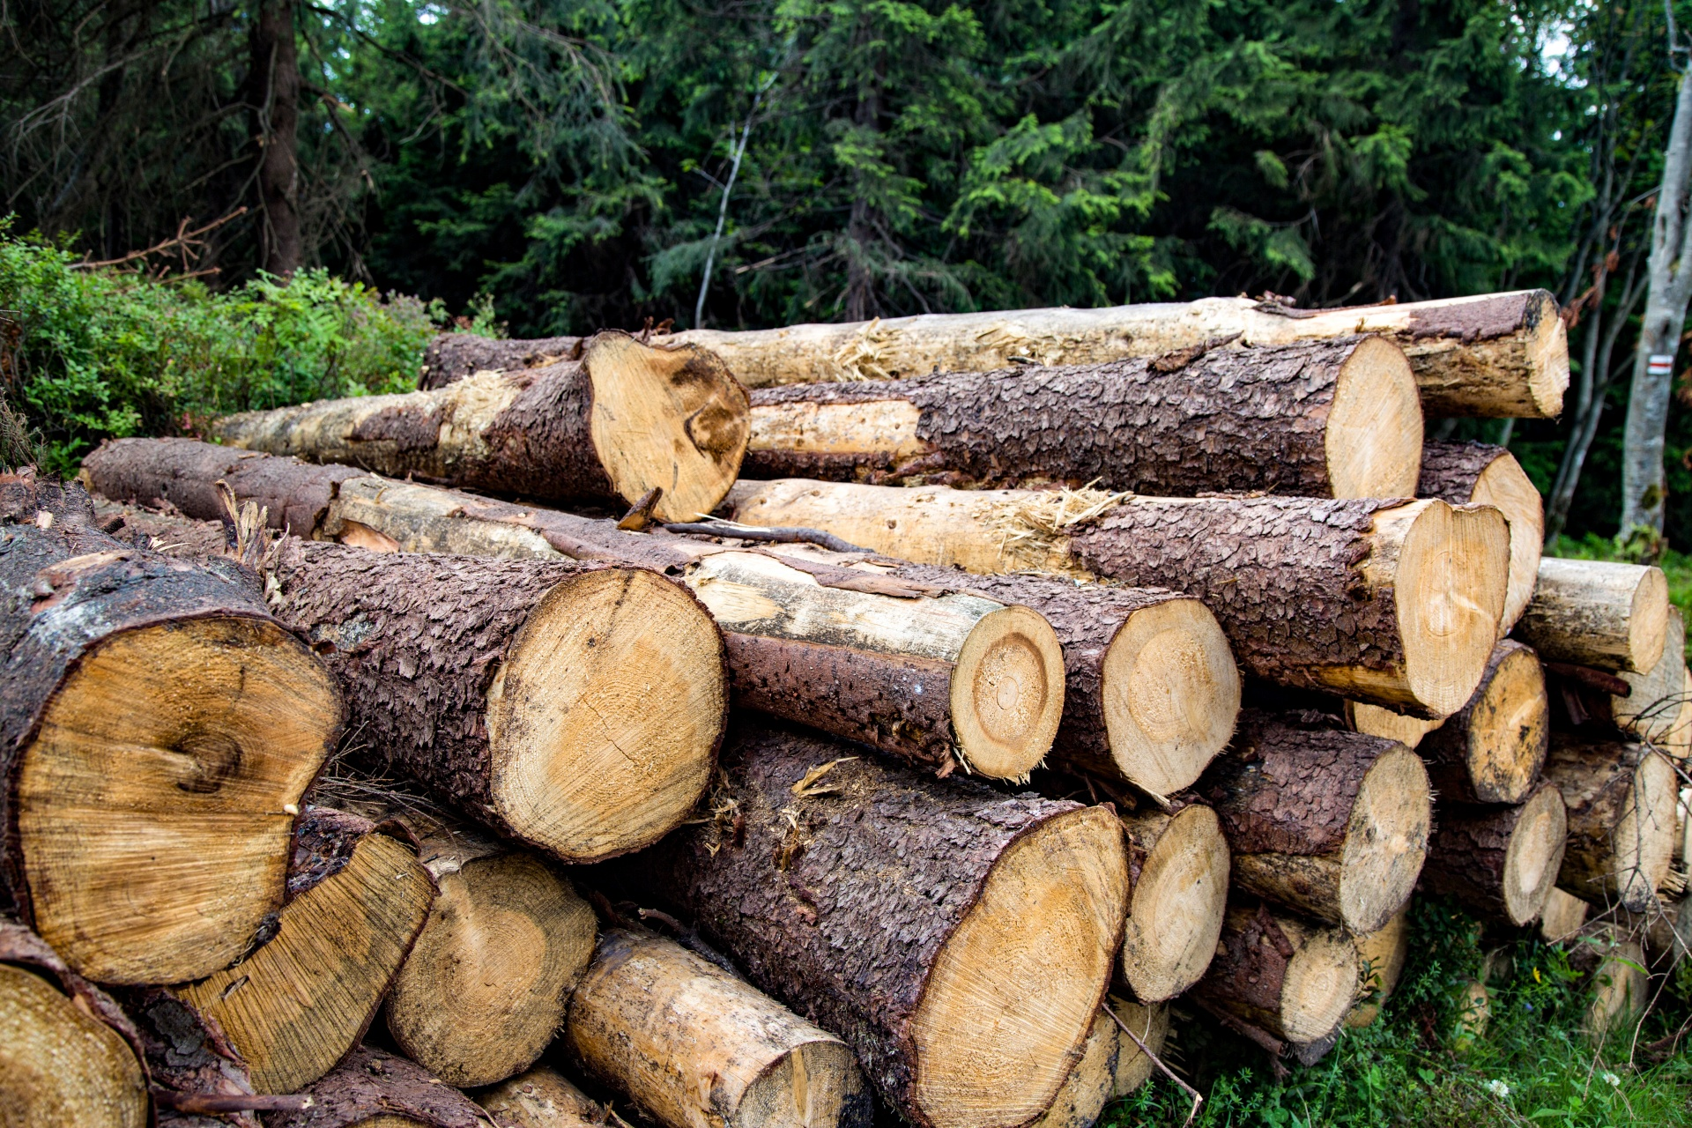
Achievements
The Shang Dynasty were the first historic Dynasty of China
The Shang Dynasty actually created writing and they named it oracle bones and from then we have used writing as one of our daily tasks
Notes:
Molly: The Shang dynasty are important because they left a legacy of Chinese Culture that provided durable and long lasting.
Ava : The Shang Dynasty were the first historic Dynasty of China
Jt : The Shang Dynasty actually created writing and they named it oracle bones and from then we have used writing as one of our daily tasks

Slide 6
How did they use our Mayhill Habits
Notes:
Ava: We think that the Shang Dynasty used a lot of our Mayhill habits, so we wanted to share a few examples with you !!
M .Collaboration: They used this habit by working together to make the Shang Dynasty become a well known Ancient Civilization.
A. Independence: They used this habit by controlling regional territories from other civilization’s.
J. Resilience: They used this habit by not giving up when they were building their cites , because if I were them, that would be difficult.
A. Critical thinking: They had to think critically how they were going to defend their city.
M . Communication: They had to communicate well because they owned a city and if something was to happen they would need to communicate to figure it all out.
A. Respect: They were respectful by listening to other ideas from their rival Civilizations.

Slide 7
The End
The Shang Dynasty should be remembered because they used a lot of imagination and creativity to make their Dynasty shine .
Notes:
Molly: The Shang dynasty believed in a supreme a god called Shang Dai and also believed in a lot of other Chinese cultures at that time.
Ava : Here are a couple of facts about the Shang Dynasty, They were not allowed to choose their jobs
Molly: They were known for their advances in math, astronomy, artwork and military technology.
JT ; Whenever the Shang army defeated someone not on their land they would take the survivors a prisoners
JT : The Shang Dynasty should be remembered because they used a lot of imagination and creativity to make their Dynasty shine . Ava: the horses were the quickest way of travel
Molly :They ate bread , wheat, cheese and dried beer

