Slide 1
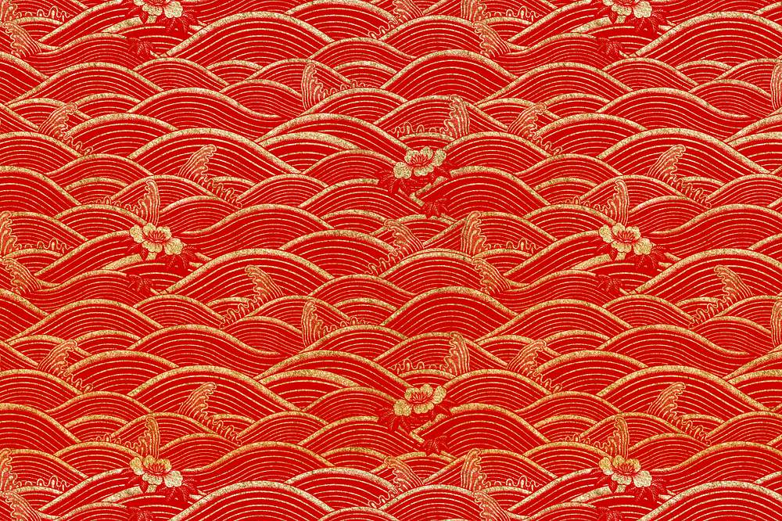
Shang Emperors
Olivia, Sofia, Teddy, Charlie
☺We are doing a presentation about the Shang Dynasty
Notes:
Olivia says: Hello and welcome to our presentation about the incredible: Shang dynasty.

Slide 2
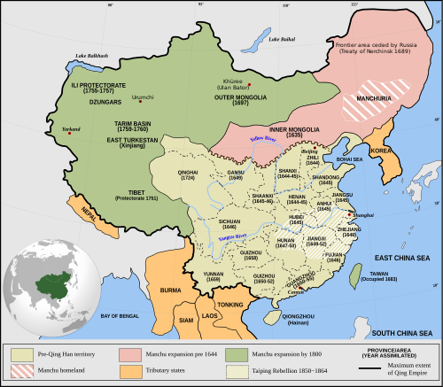
Where in the world?
Shang dynasty is located ,in Western China.
Shang dynasty settled near the Yangzi river and the yellow river.
The climate was mild and rainy.
They had vast forest ,around the yellow river.
This Photo by Unknown Author is licensed under CC BY-SA
Notes:
Sofia reads the first line
Charlie reads the second line.
Teddy reads third line.
Olivia reads last line. Shang dynasty is located in the North China plain ,in Western China.
Shang dynasty settled near the yellow river also known as the: Yangzi river.
In the Shang dynasty, the climate was mild and rainy.
They had vast forest that covered the ground around the yellow river

Slide 3
When Did It Start?
Shang dynasty started in 1600 and ended in 1000 BC.
Part of China was ruled by the Shang dynasty.
Ultimately, the Shang Dynasty was overthrown in 1046 BCE by the Zhou a subject people –a people who lived under imperial rule-living ,in the western part of the kingdom.
Britain was being attacked by the Normans!
King Charles the 1st was in charge of Britain at the time.
Notes:
Charlie will read first line
Teddy will read second line
Sofia will read third line
Olivia will read last lineShang dynasty started in 1600 and ended in 1000 BC.
For 500 years, part of China was ruled by the Shang dynasty.
Ultimately, the Shang Dynasty was overthrown in 1046 BCE by the Zhou a subject people –a people who lived under imperial rule-living in the western part of the kingdom, but their cultural contributions carried on through future dynasties.
During the era, Britain was being attacked by the Normans!
King Charles the 1st was in charge of Britain from [1600 – 49 B]

Slide 4
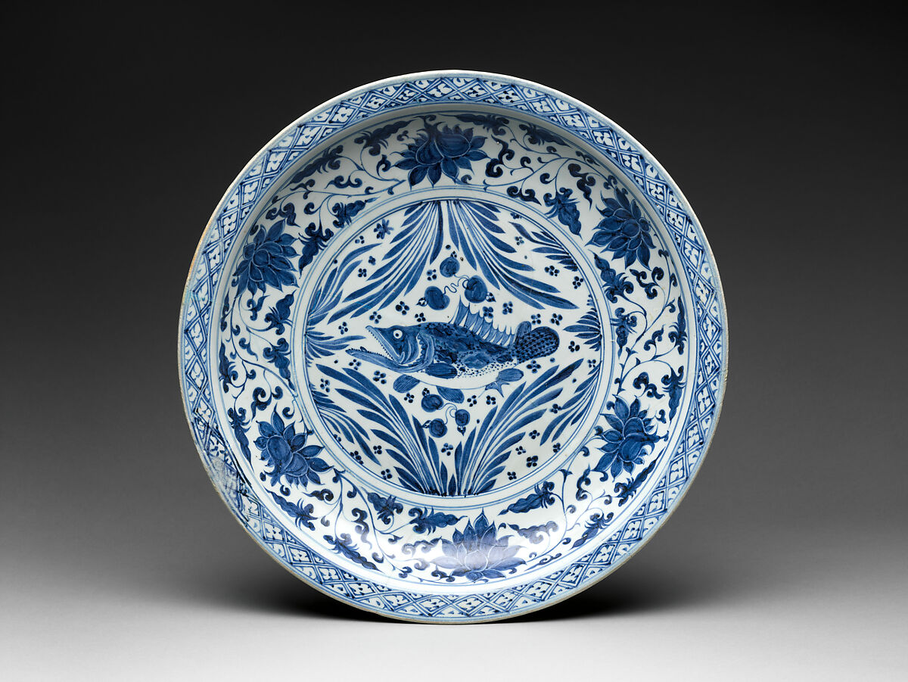
What Skills Did They Have?
Shang Dynasty craftspeople mastered Bronze, an alloy of copper and tin.
There were several large settlements including Zhengzhou and Anyang, though these are not believed to be densely urban . Anyang became the capital around 1300 BC. Under King Pan and at the time is was called Yin.
The Shang used wheeled carts for transport in times of peace and chariots for hunting . They used canoes for local trade. Cowrie shells show they traded with coastal dwellers.
This Photo by Unknown Author is licensed under CC BY-NC
Notes:
Charlie reads first part
Sofia reads second partShang Dynasty craftspeople mastered Bronze, an alloy of copper and tin; bronze weapons gave Shang foot soldiers and charioteers a tactical advantage in combat.
During the Shang Dynasty, there were several large settlements including Zhengzhou and Anyang, though these are not believed to be as densely urban as Mesopotamian settlements during the same time. Anyang became the capital around 1300 BC. Under King Pan and at the time is was called Yin.
The Shang used wheeled carts for transport in times of peace and chariots for hunting and as a means of overseeing warfare. They also used canoes for local trade. Cowrie shells show they traded with coastal dwellers but they did not trade with further afield

Slide 5
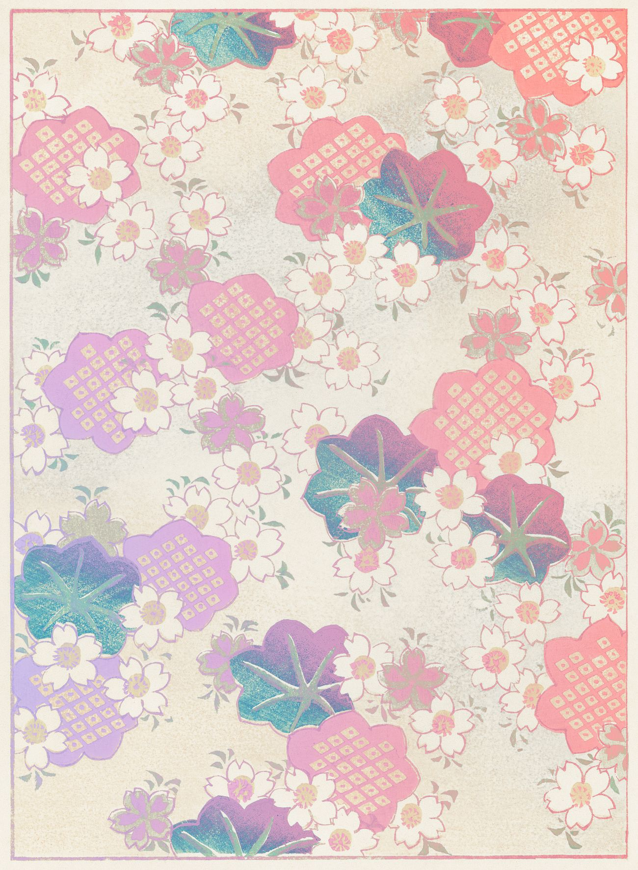
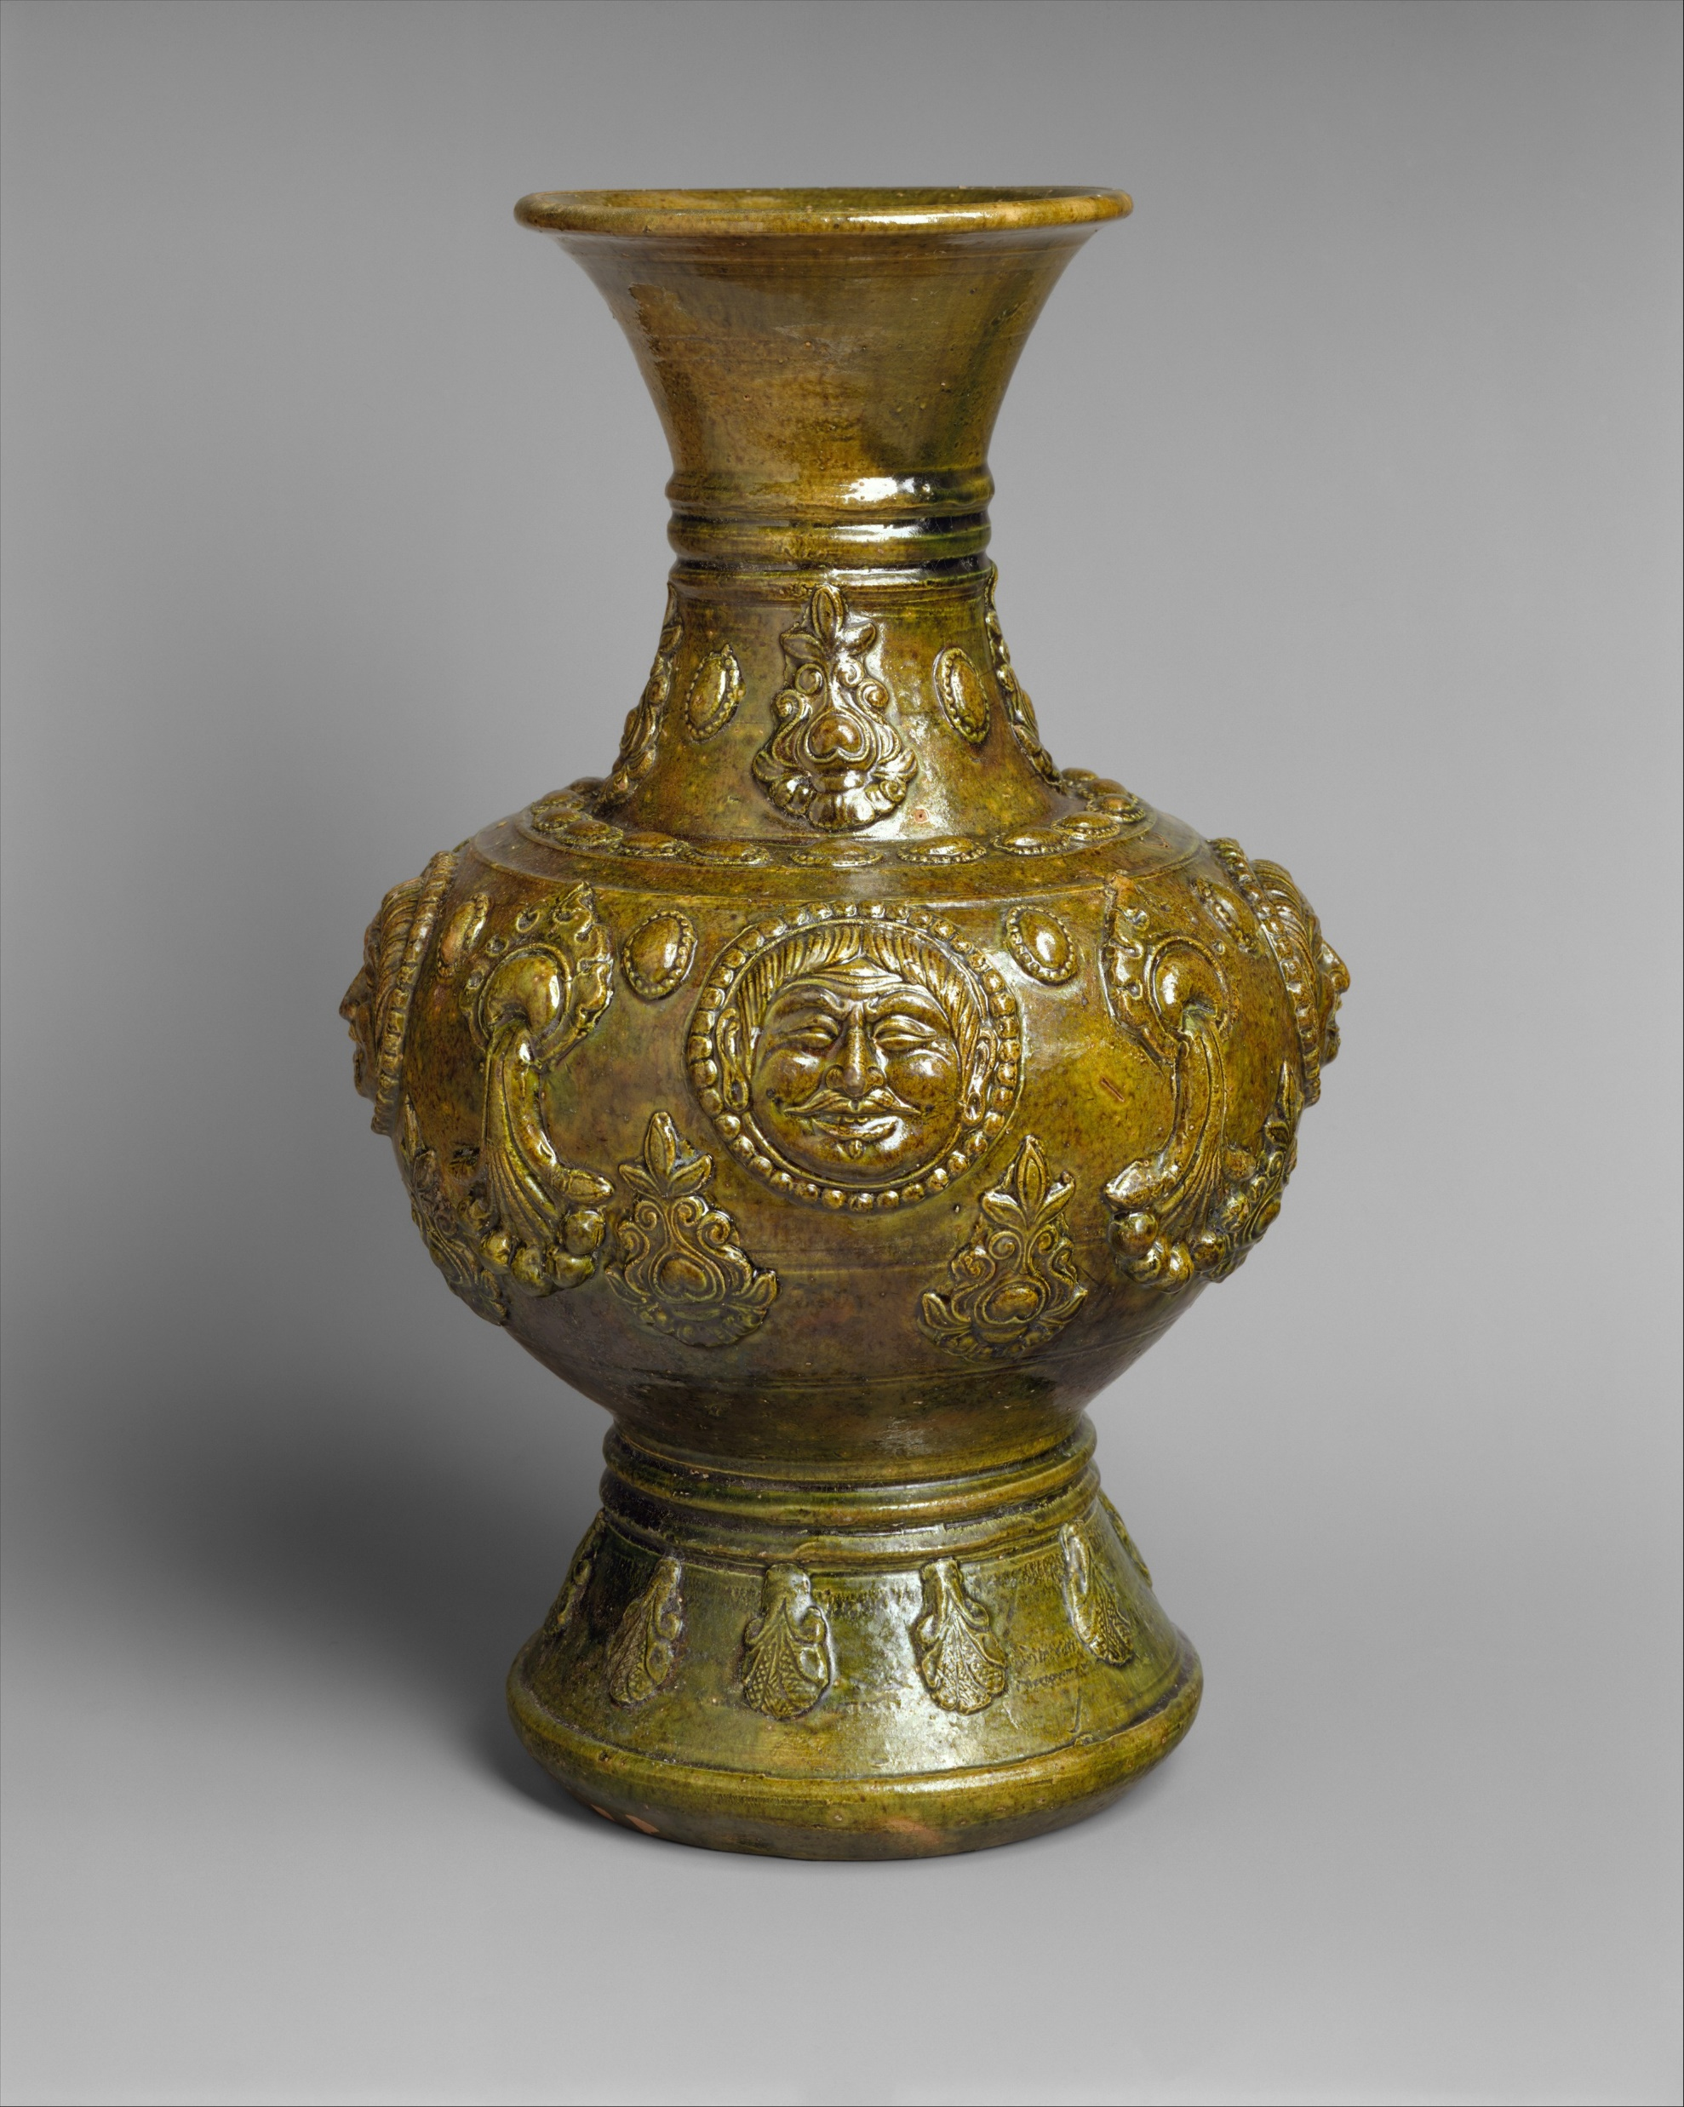
Were They First To Do Something?
The Shang dynasty made many contributions to Chinese civilization, but four in particular define the dynasty: the invention of writing; the development of a stratified government; the advancement of bronze technology.
Notes:
Sofia will Read paragraphThe Shang dynasty made many contributions to Chinese civilization, but four in particular define the dynasty: the invention of writing; the development of a stratified government; the advancement of bronze technology; and the use of the chariot and bronze weapons in warfare.

Slide 6
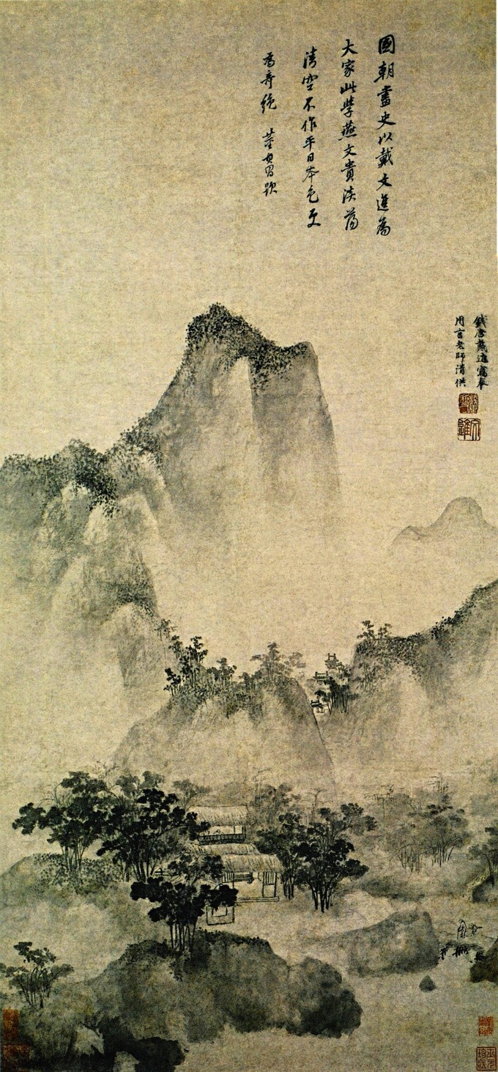
The Shang dynasty significance!
The Shang Dynasty should be remembered because it is the earliest ruling dynasty of China to be established in recorded history, though other dynasties predated it. The Shang ruled from 1600 to 1046 B.C. They were known for their advances in math, astronomy, artwork and military technology.
This Photo by Unknown Author is licensed under CC BY-SA
Notes:
The Shang Dynasty should be remembered because it is the earliest ruling dynasty of China to be established in recorded history, though other dynasties predated it. The Shang ruled from 1600 to 1046 B.C. and heralded the Bronze Age in China. They were known for their advances in math, astronomy, artwork and military technology.

Slide 7
The end
Thank you for listen to our presentation☺

