Slide 1
Welcome

Slide 2
Shang Dynasty
Grace, Chloe, Sava and Slava
The Shang Dynasty Goats
Greatest of all time
Notes:
Title and names

Slide 3
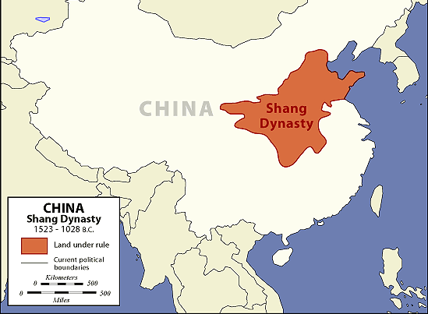
China
The Shang Dynasty was next to the River Yangzi and the Yellow River or, in China known as the Huang He.
The land around them was covered with many mountains making it easier to defend.
Notes:
The Shang Dynasty was in China next to the River Yangzi and the Yellow River or, in China known as the Huang He.
The land around them was covered with many mountains making it easier to defend and helping the civilization thrive.

Slide 4
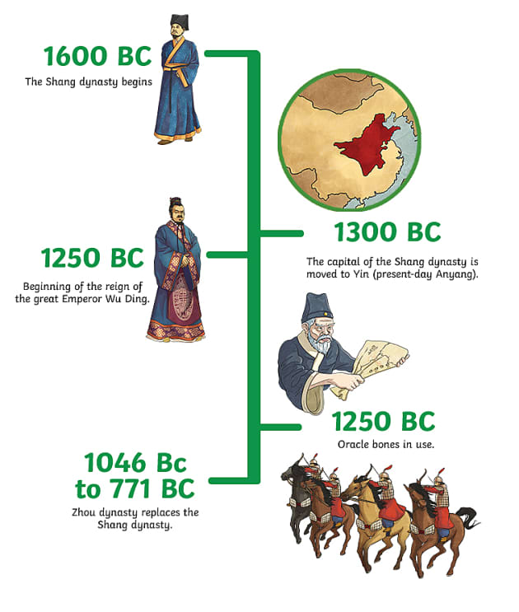
Beginning to end
The Shang Dynasty started in 1046 BCE (BC)
and ended in 1600 BCE (BC).
So they lasted 54 years in total.
The last emperor they had was Di Xin.
The Shang Dynasty were the first dynasty of China.
Notes:
The Shang Dynasty started in 1046 BCE (BC)
and ended in 1600 BCE (BC).
During this time they had over 30 emperors.
The last emperor they had was Di Xin and after he was overthrown the Shang Dynasty came to an end.
The Shang Dynasty were the first dynasty of China.

Slide 5
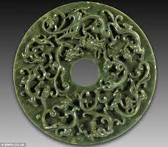
Skills They Used
The Shang Dynasty used a lot of bronze to create weapons armour and tools.
They are also famous for crafting many items of jewellery and artifacts using Jude.
Some of these are still around today but because of their rarity they go for millions, so you better start saving up.
All of their houses were made out of wood, a bit plain and boring although they were very functional.
Notes:
The Shang Dynasty used a lot of bronze to create weapons armour and tools.
They are also famous for crafting many items of jewellery and artifacts using Jude.
Some of these are still around today but because of their rarity they go for millions, so you better start saving up.
All of their houses were made out of wood, a bit plain and boring although they were very functional.

Slide 6
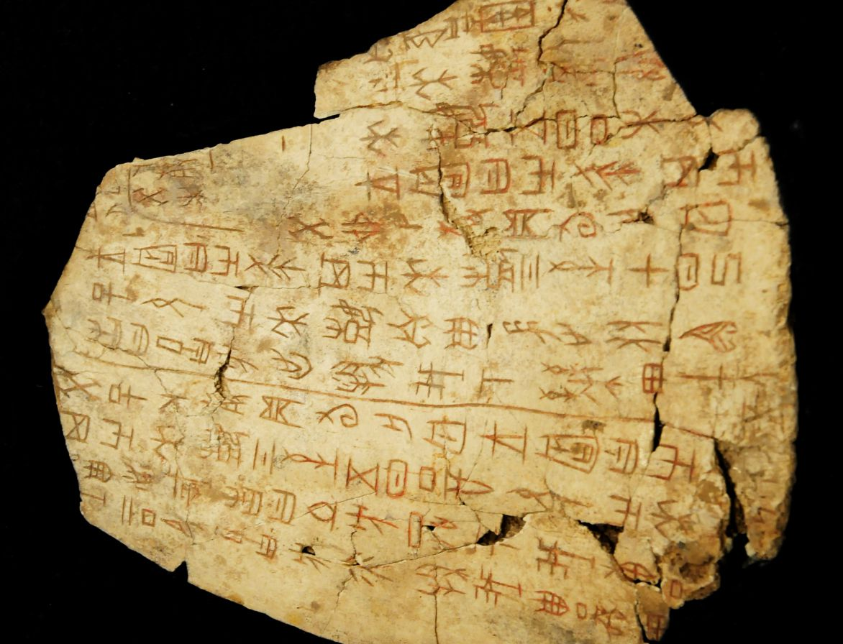
Great achievements
The Shang Dynasty are famous for many things.
Making things out of jade
The development of an arranged government
Developed knowledge of maths
The use of the chariot and bronze weapons in war.
Their greatest achievement was creating writing, although we expect that their writing would have been a bit different than ours.
Notes:
The Shang Dynasty are famous for many things such as: Making things out of jade; the development of an arranged government; developed knowledge of maths; and the use of the chariot and bronze weapons in war.
Their greatest achievement was creating writing, although we expect that their writing would have been a bit different than ours.

Slide 7
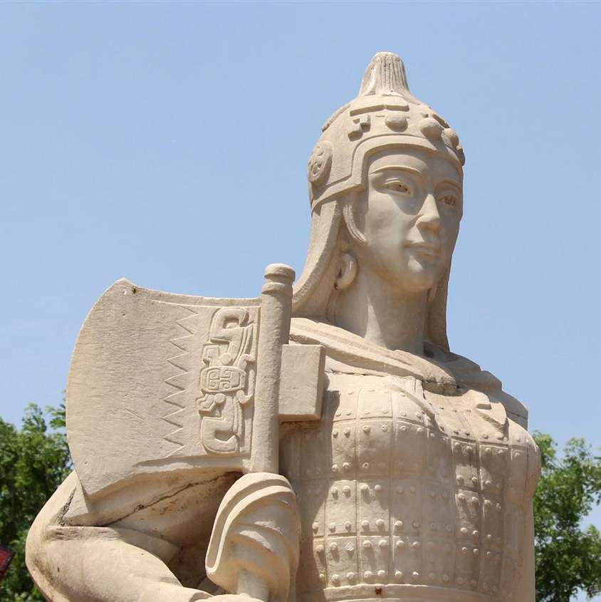
Lady Fu Hao
Notes:
Zhengzhou and Anyang were two of the biggest cities in the Shang Dynasty.
Fu Hao or Lady Fu was one of Wu Ding’s 64 wives but she became the second most powerful, she lead an army of 10,000 men and she won many battles. In 1250 BC she was buried in Anyang and her grave features 16 human sacrifices, including children; valuable objects and weapons made from bronze and jade.

Slide 8
The Shang Dynasty are the best
Because our China today wouldn't be the
same without them.
The End
☺

