Slide 1
SUPER SUMERIANS
Daisy Ewan Harry

Slide 2
Location
Sumarians settled in and around Iran and Iraq , the terrain was used for farmland and development. The ground will have been able to grow crops and this land was called the Furtile cresent , the rivers were called the river Tigres and Euphrates .
Notes:
It was where farming began there was also ri vers near by so that they had water and food this also was good for trade

Slide 3
Development
They lived around 5300 BC - 1940 BC their rein ended around the early bronze age periods ,the first king of sumaria was called Aluliumwho was ruler of Eridu this was a city .
Nomads were living in the area and began to settle there.
They built small houses, this developed ,and soon into advanced city states.

Slide 4
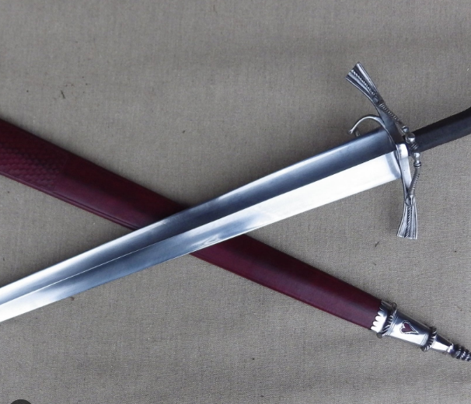
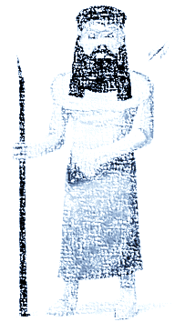
POPULARITY
The sumers were famous for writing, they also used laws and science and used animals not just as farm work, but also ate them we also use there influence today.
Notes:
Today we eat meat and we also do arythmatic geomagry irrigation saws and sandles

Slide 5
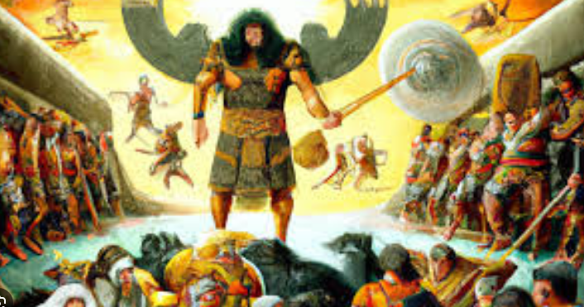
VICTORIOUS LEADERS
The wheel
Chariots and horse and cart
Scrolls that we discovered
And they used slavery
Notes:
They used potter wheels reeds for writing marks in clay meant words . They were also first to use copper bronze and iron weapons The Sumarians were great leaders, as they were the first to use many things that are still influencing us today, some of these things were like ,the wheel they would use chariots and horses and cart to get around, ancient Sumaria. They used scrolls that we discovered . There was written research, that slavery was used in Mesopotamia

Slide 6
Why THEY ARE THE BEST
Sumarians should be remembered in history, because of their historical significance , they were the first to use things they were known for advanced writing
Literature agriculture architecture arts religious systems government and more

