Slide 1
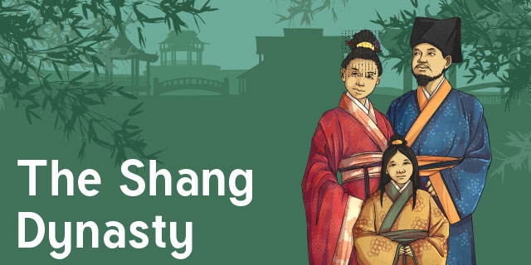
All About The Shang Dynasty
BY THE POTATO DYNASTY (Robert, Deacon, Bob, Kourtney, Leafy!)
Notes:
Deacon: We are the potato dynasty and this Power Point is all about the Shang Dynasty!

Slide 2
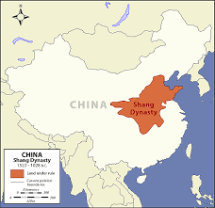
Where it all happened
The Shang Dynasty was founded in China!
The Shang Dynasty was the first historic Dynasty in China!
Fun fact it was located in the sub-tropics making the climate perfect for a thriving
civilisation!
The Shang city was surrounded by defensive mud walls
There were two major rivers for the Shang Dynasty The yellow river and the Yang Ze river
Notes:
Robert: The Shang Dynasty took place in China, the weather would have been nice and hot due to the fact that it was in the Subtropics. In this area there were two major rivers running through it: the Yellow river and the Yang Ze river

Slide 3
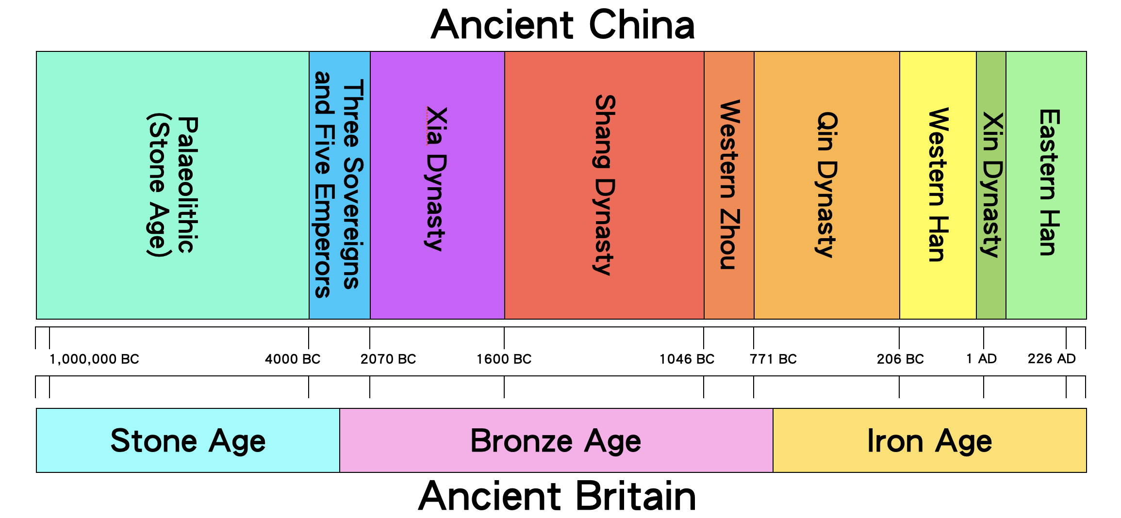
When and how it started
The Shang Dynasty started in 1600 BCE circa when Tang Shang defeated the evil king Jie of the Xia Dynasty.
It ended around 1050BCE
Tai Wu, the ninth Shang Emperor, reportedly ruled for 75 years
Notes:
Kourtney: The Shang Dynasty started in 1600 BC circa when Tang Shang defeated the evil king Jie of the Xia Dynasty.
It ended around 1050BCE.

Slide 4
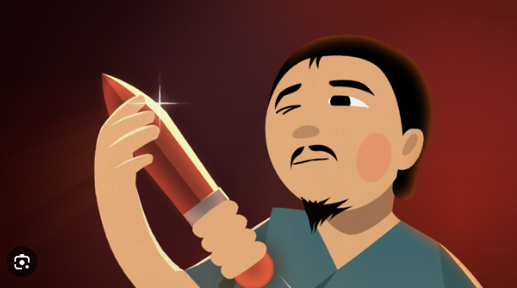
Knowledge skills and traditions
The people of the Shang Dynasty had many skills and talents such as:
They invented a type of writing
Stratified Government
Jade carving
Advanced bronze technology
Chariot racing
Mathematics
Astronomy
Notes:
Deacon: The people of The Shang Dynasty had many skills including: jade carving; they could make beautiful pottery out of the stuff, they made advanced bronze technology, they made a writing system too!

Slide 5
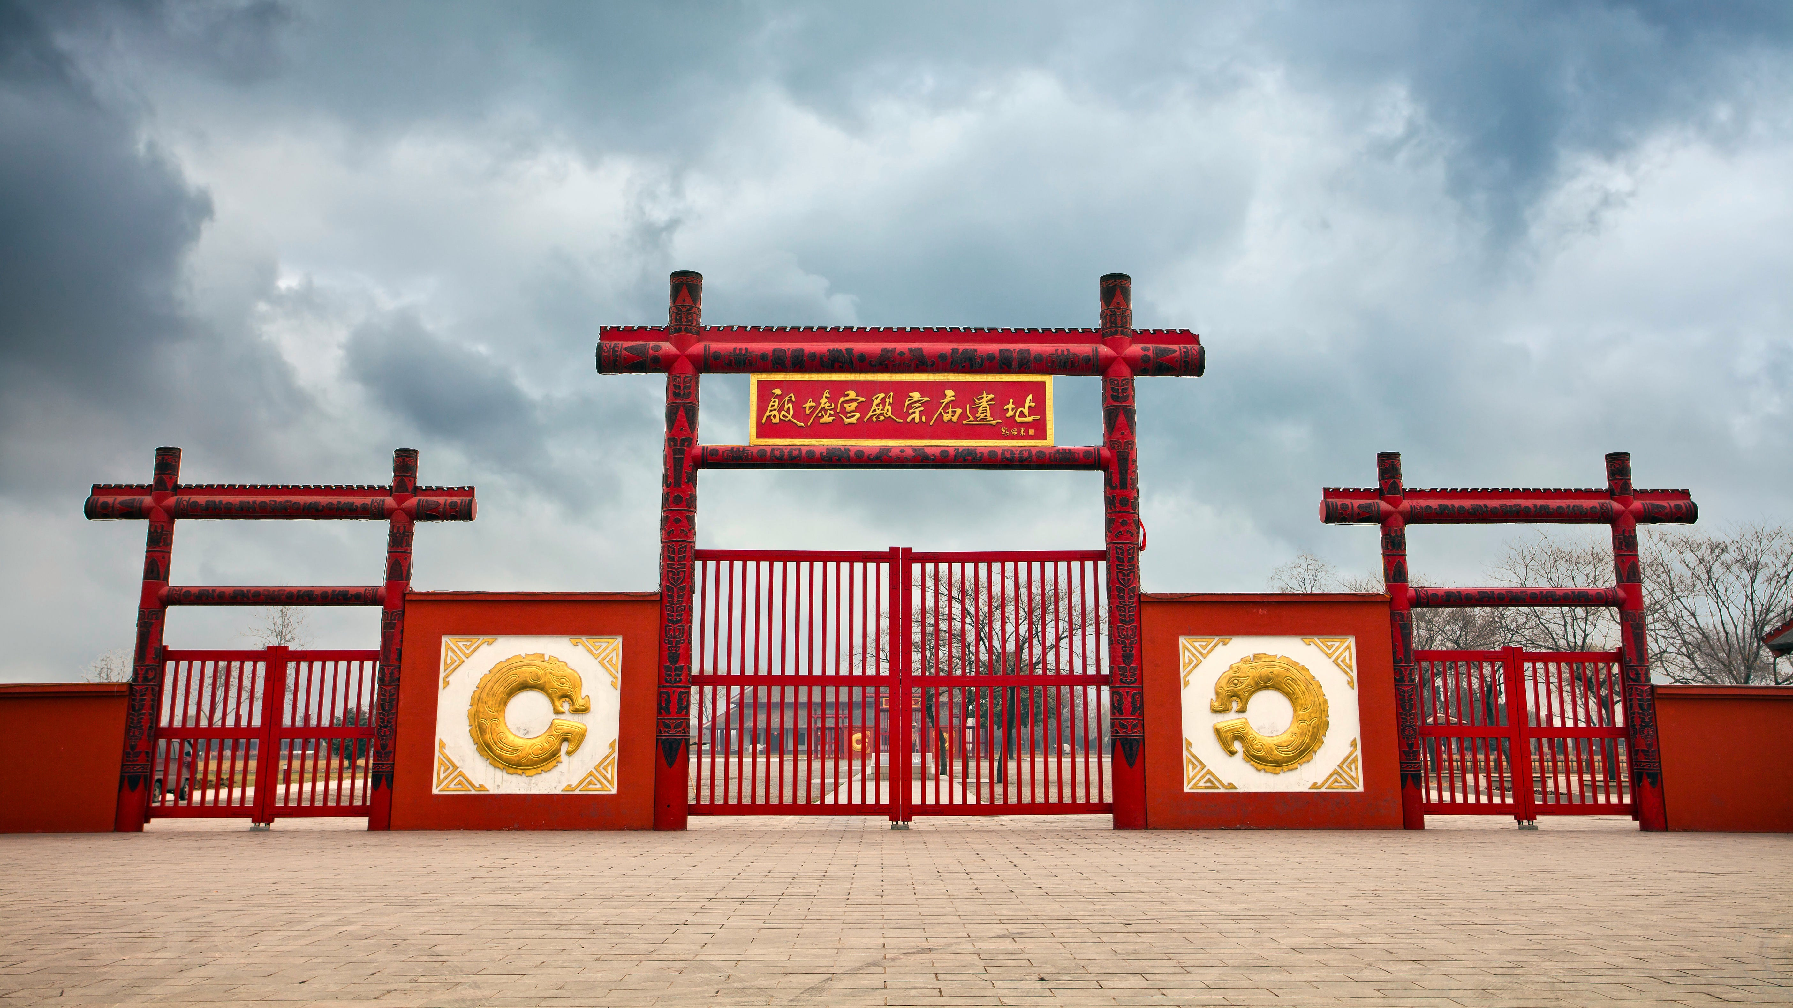
Great Achievements
This Dynasty were the first to do a lot of things such as:
They were the earliest ruling Dynasty in China
The first Lunar and Solar calendar was made there
And they established a year being 365 days
Notes:
Kourtney: The Shang Dynasty achieved many different feats. They were actually the earliest historic Dynasty! They also created the first Lunar and Solar calendar, as well as making the year 365 days!

Slide 6
The Shang Dynasty Itself
was firmly established civilization. A The Shang dynasty he Dynasty also worshipped a supreme god; significant battle in this time was the Battle of Mingtiao.
Notes:
Robert: was firmly established civilization. A The Shang dynasty he Dynasty also worshipped a supreme god; significant battle in this time was the Battle of Mingtiao.

